Slide 1

“But the Spirit makes us sure God will accept us because of our faith in Christ”
Galatians 5:5

Slide 2
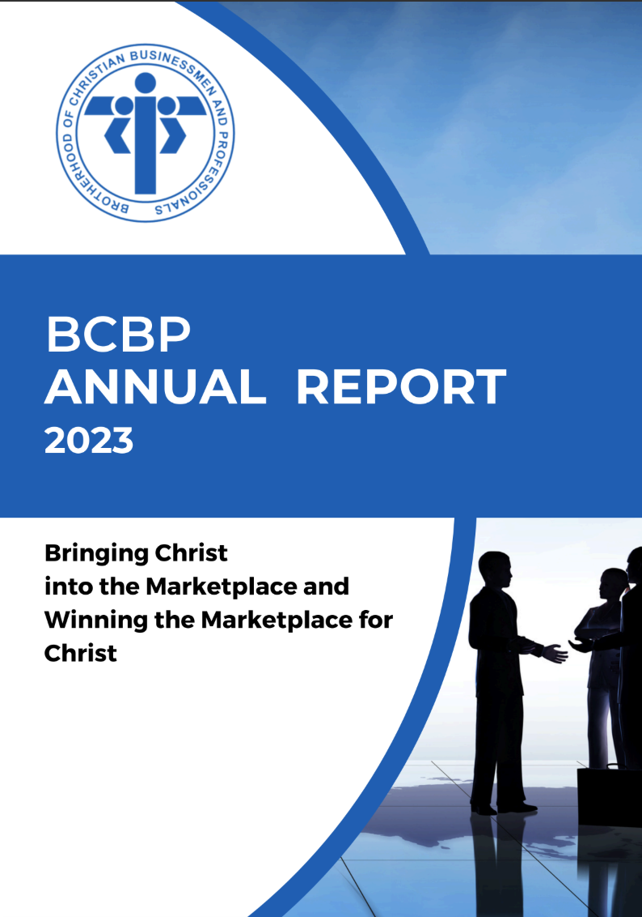
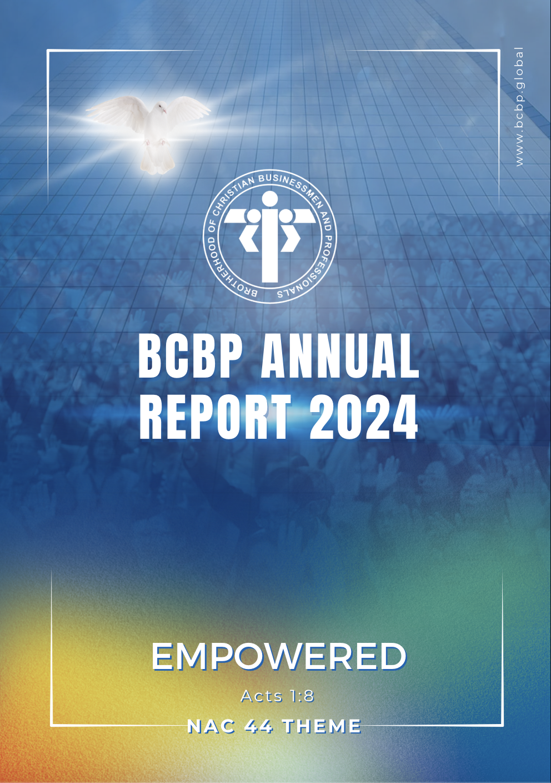
2023
2024

Slide 3
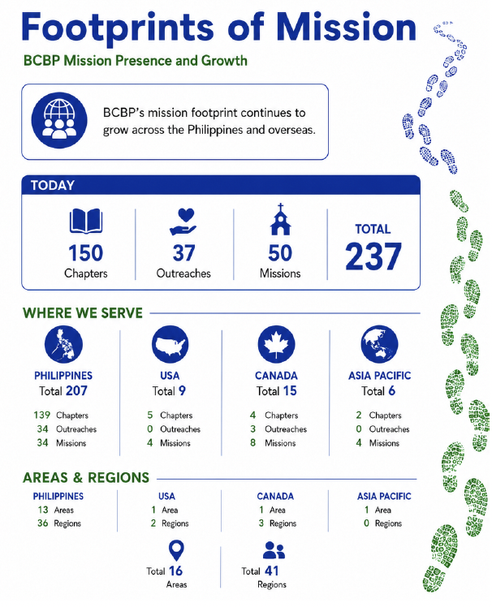

Slide 4
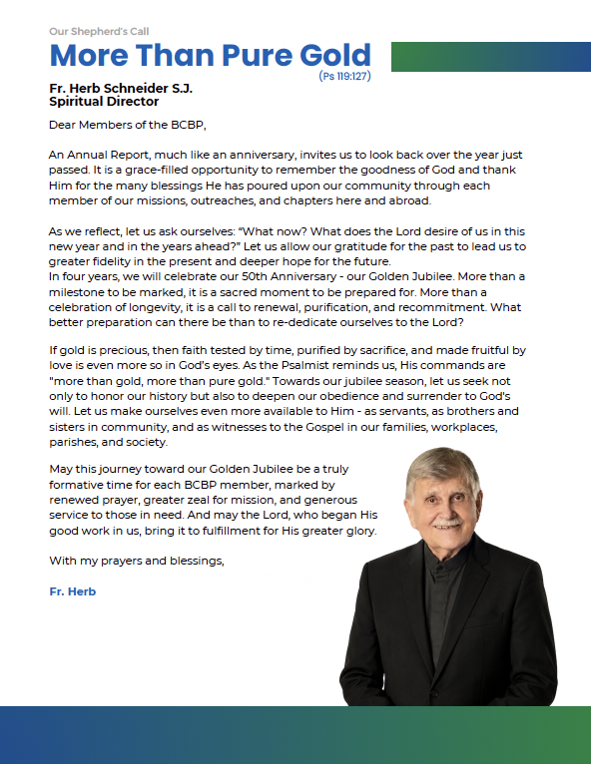
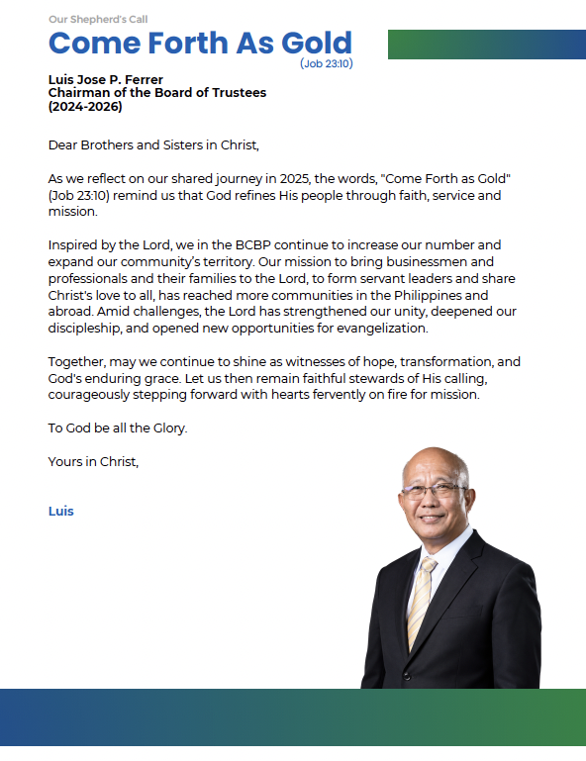
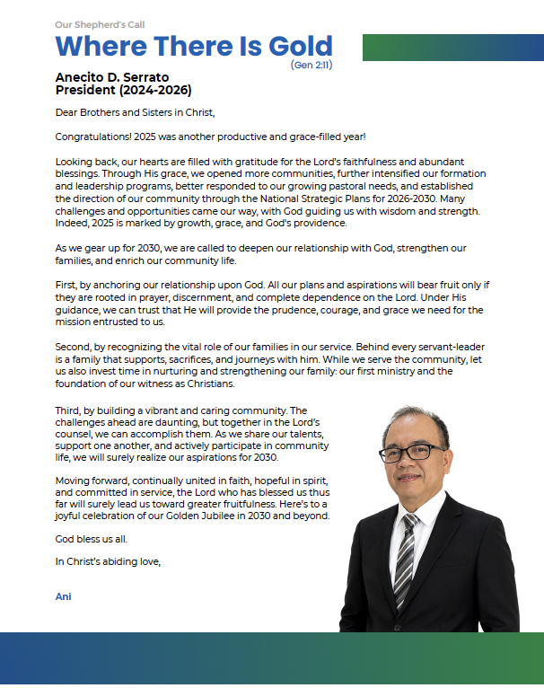
Notes:
It is with deep gratitude that I present our BCBP 2025 Annual Report.
In it, we are greeted with messages from our Founder and Spiritual Director, Fr. Herb, Chairman Luis Ferrer, and President Ani Serrato.

Slide 5
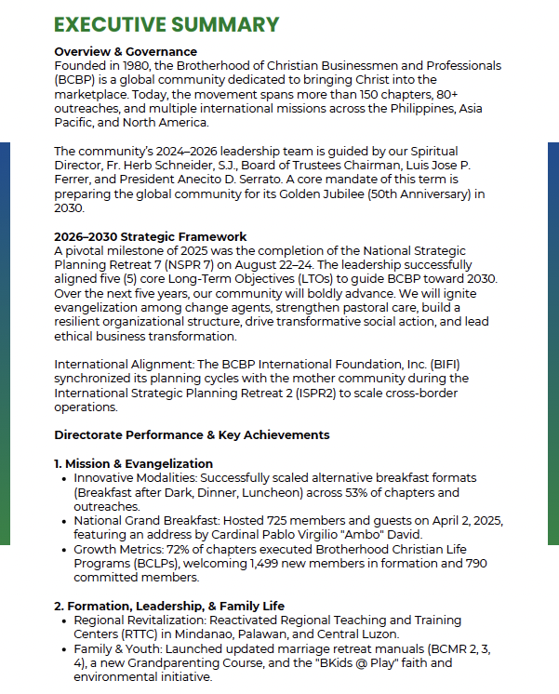
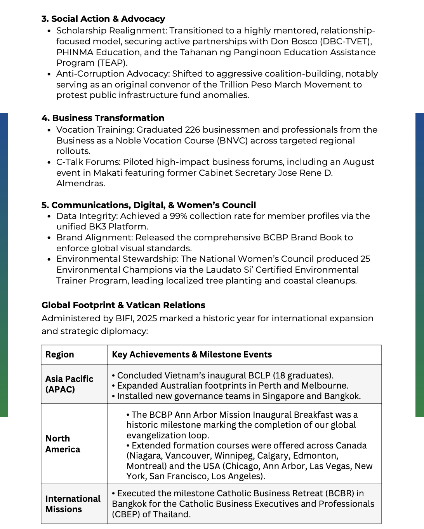
Notes:
An Executive Summary of the BCBP Annual Report (AR2025) is a concise overview that captures the essence of the full report, designed to give us a clear snapshot of the community’s progress, priorities, and vision without needing to read the entire document.

Slide 6
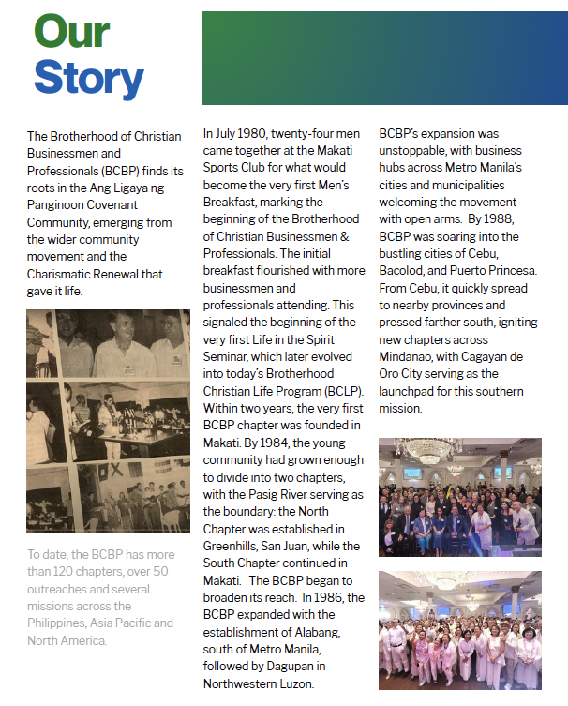

Notes:
“As members of the BCBP community, we are called to always look back to our story—because it reminds us of the grace that brought us here, the mission that binds us together, and the identity we carry as Christ’s servants in business. Remembering who we are strengthens our unity, deepens our faith, and guides us as we move forward in building a future anchored in integrity and love.”

Slide 7
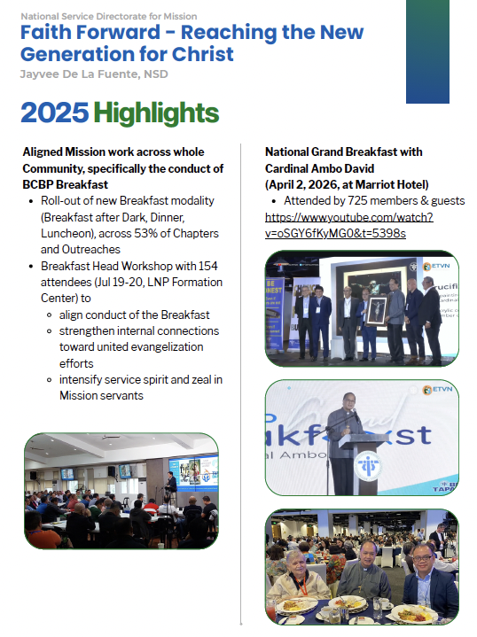
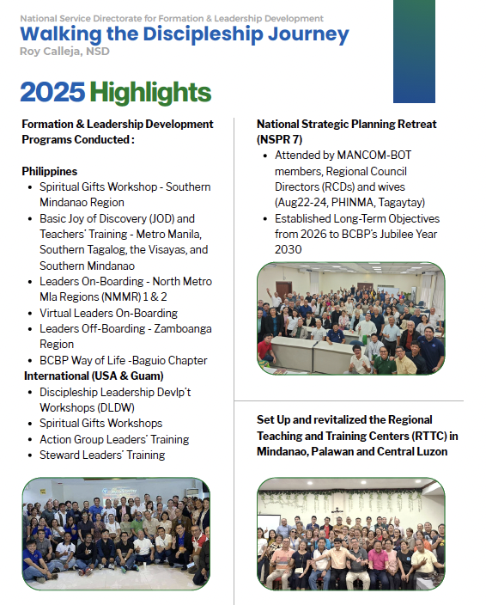
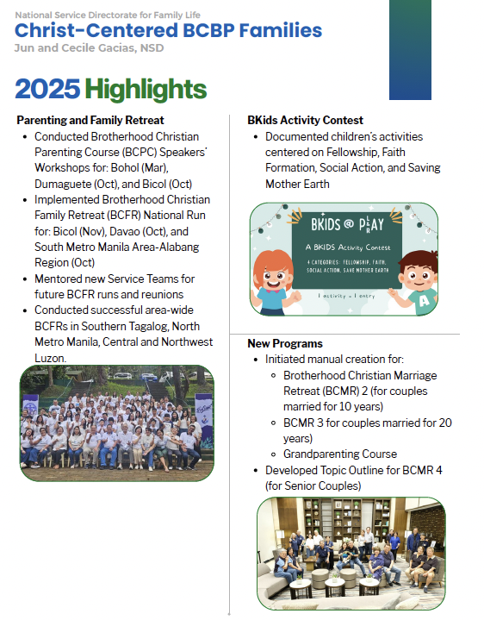
Notes:
Close to 90 pages, the report may seem intimidating, but don’t worry… it celebrates milestones, reflects on challenges, and recognizes the quiet, powerful acts of service by the men and women of BCBP.

Slide 8
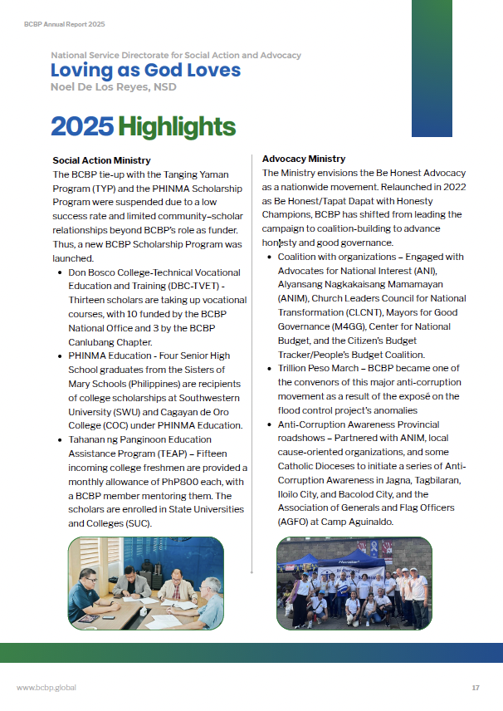
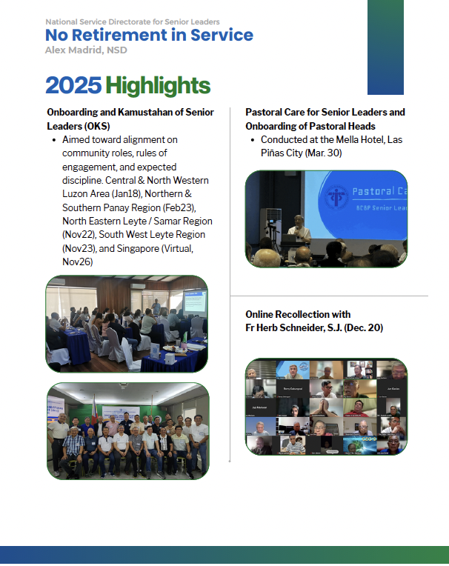
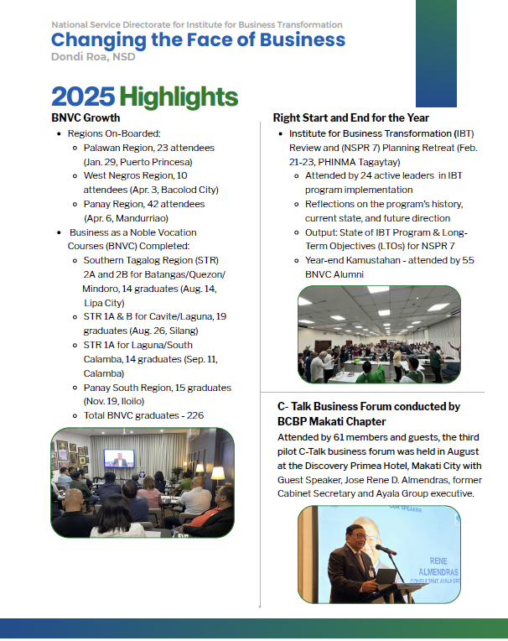
Notes:
You’ll see the fruits of our efforts—the highlights and achievements of our Directorates and spiritual moments that shaped us this past year

Slide 9
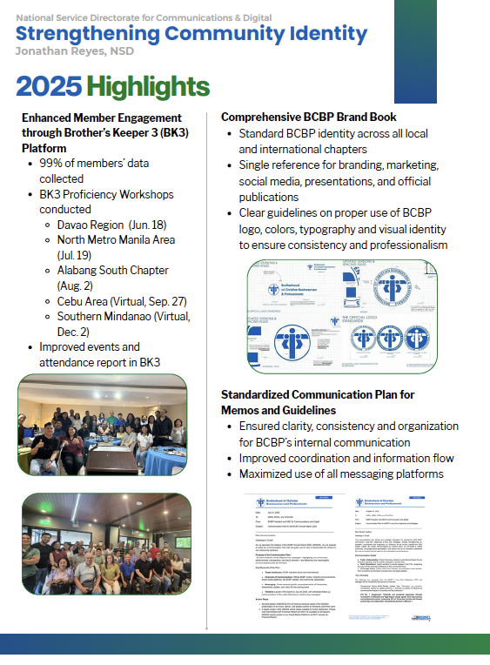

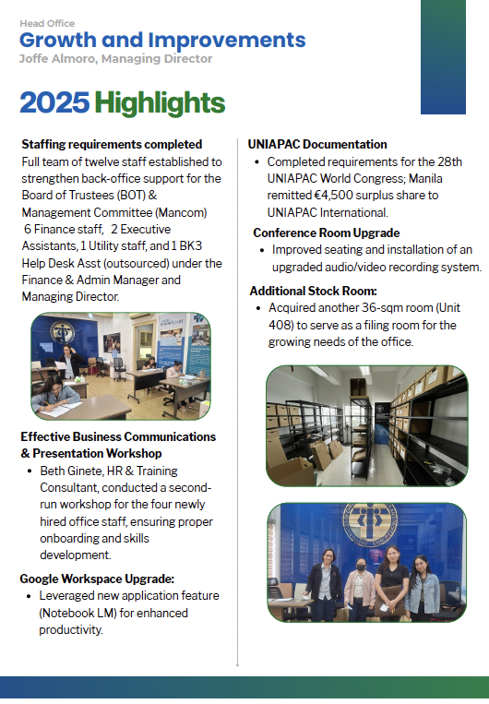
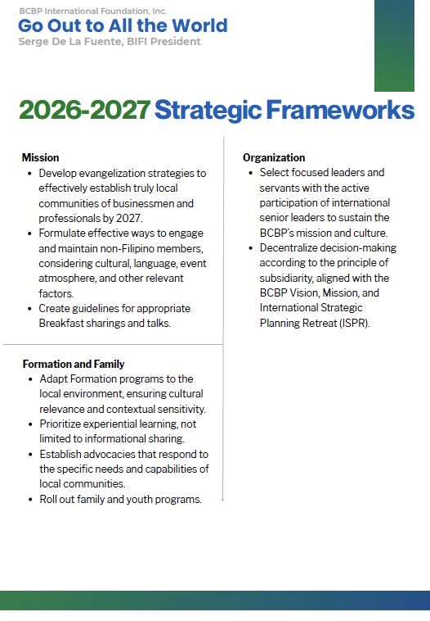
Notes:
The same Directorates will cast a shared vision for the future, 2 or 3 Strategic Frameworks for 2026 and beyond, where God might be leading us next, and how each one of us can be part of that plan.

Slide 10
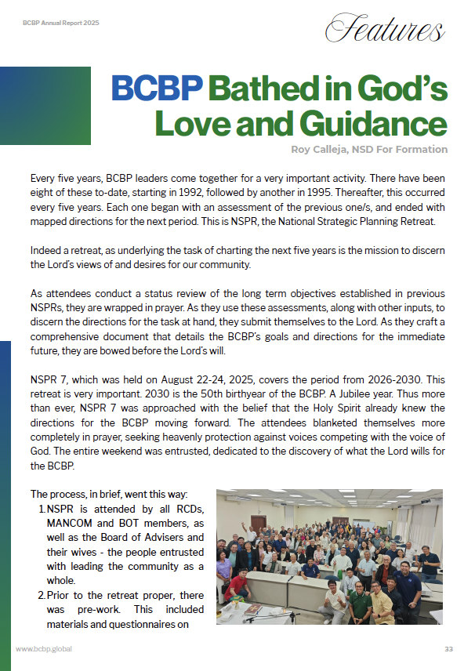
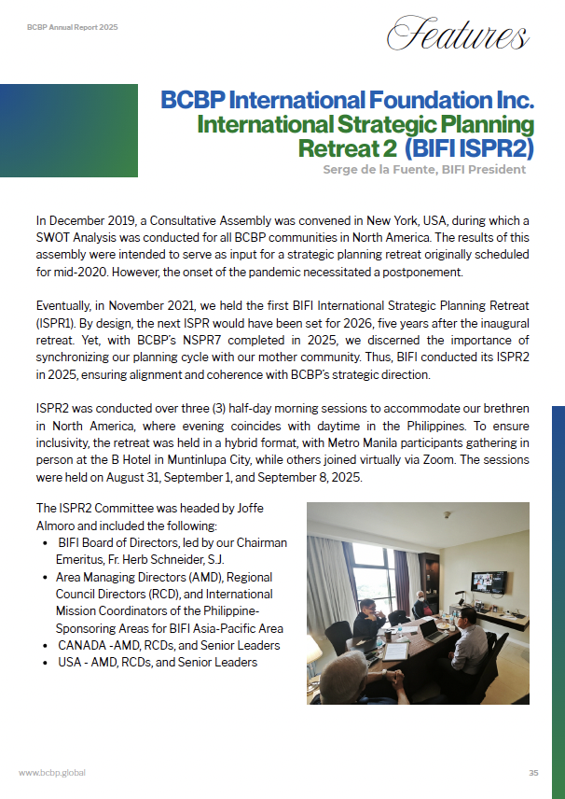
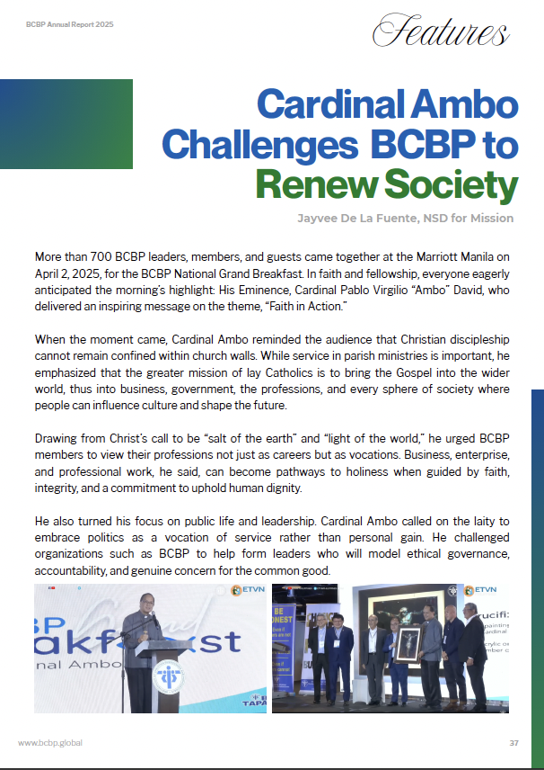
Notes:
Feature stories showcase real experiences and testimonies from members, chapters, or directorates that embody the values of BCBP. They bring to life how Christ-centered business practices, stewardship, and community service have made a tangible impact. Instead of just reporting achievements, they tell the story behind the achievement—making the 2025 Annual Report more relatable, inspiring, and memorable.

Slide 11
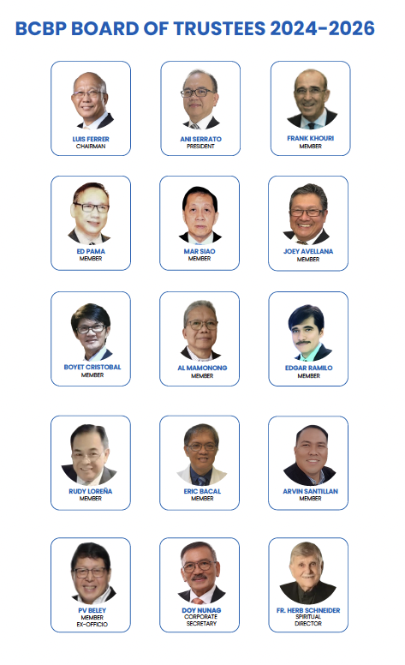
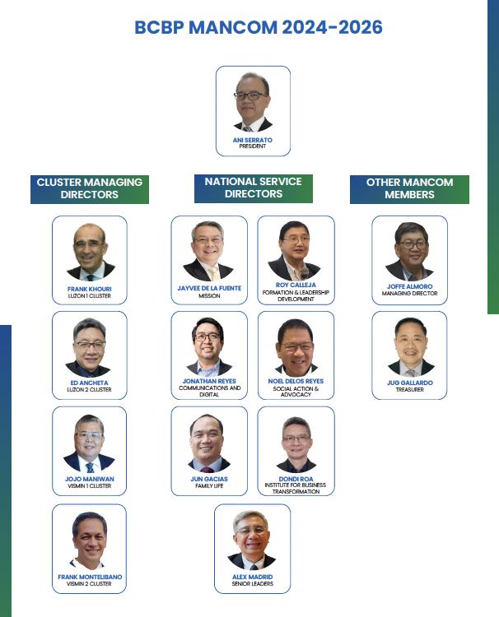
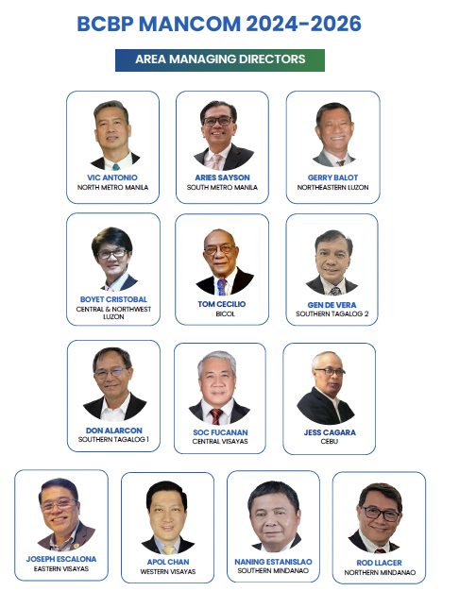
Notes:
Behind all this hard work stand our dedicated servant leaders.
You will meet each one in this report: members of our BOT and MANCOM

Slide 12
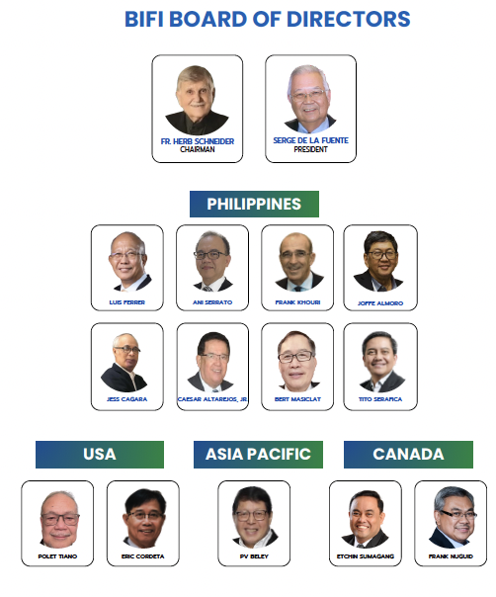
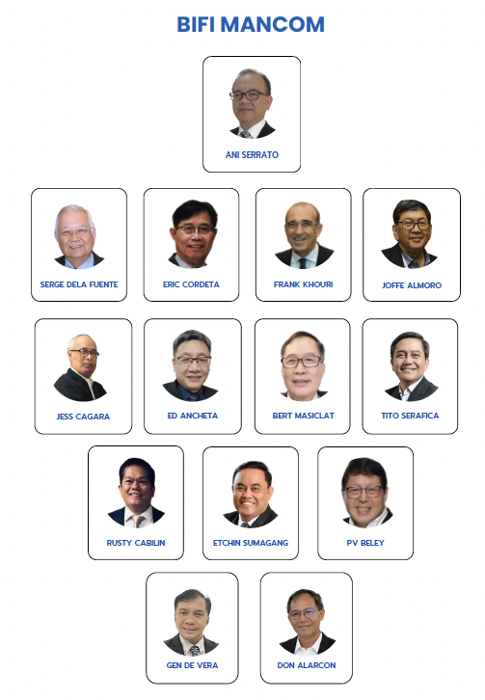
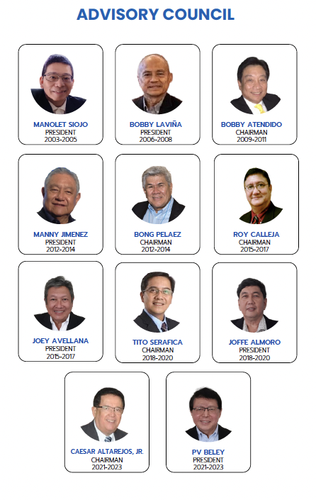
Notes:
You would also see members of BIFI or the Brotherhood International Foundation, Inc who serves as leaders for our international communities from USA, CANADA and the Asia Pacific region.
You will also see the members of our Advisory Council which is comprised of past Presidents and Chairmen.

Slide 13
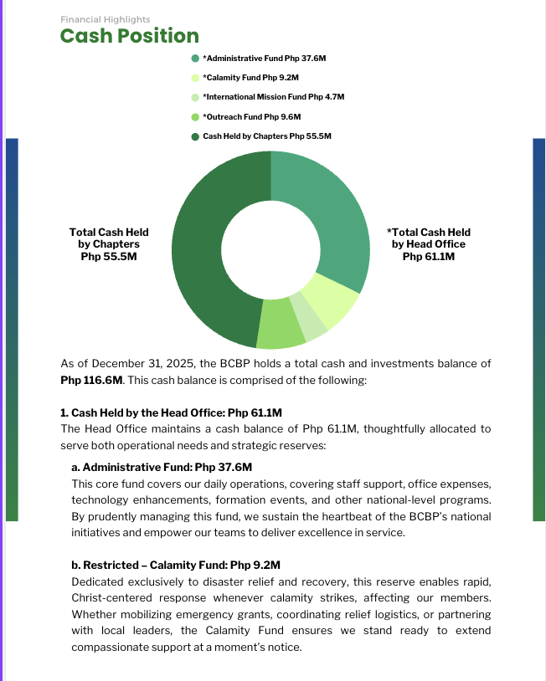
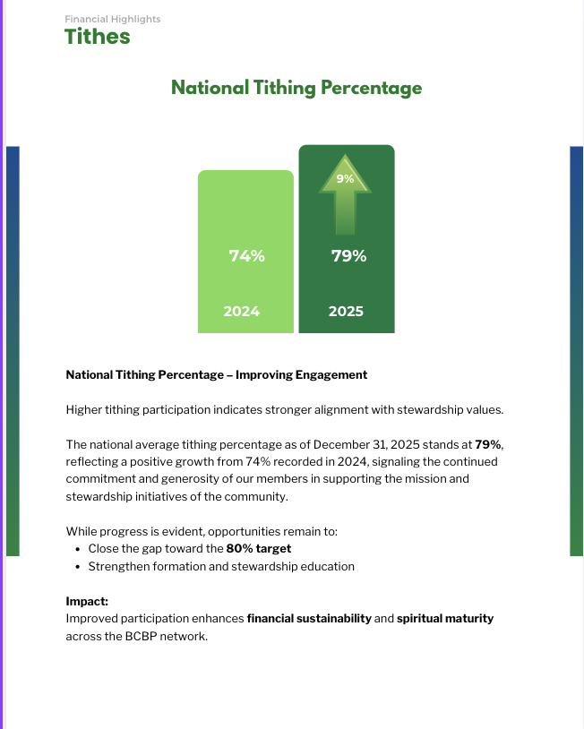
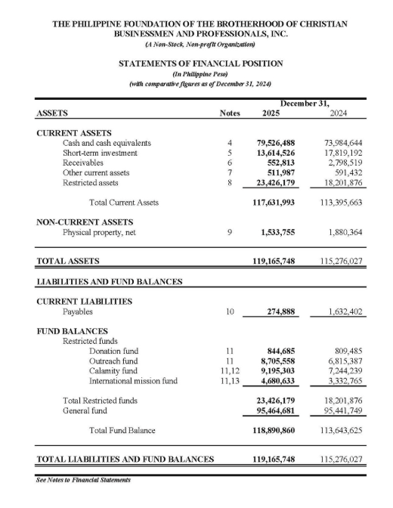
Notes:
And what would an Annual Report be without its Financial Statements? Financial reports reflect stewardship and resource management practices, thus reinforcing accountability and the wise use of tithes and contributions. To safeguard our privacy, however, we will not include these financial reports on social media posts, such as in Kapatiran FB.

Slide 14
INVITATION
Reflect
Appreciate
Re-commit
Notes:
Finally, brothers and sisters, let us all recognize that this AR2025 is more than a formal report - it’s an invitation for each of us to reflect, to appreciate, and to re-commit ourselves through our service ministries.

Slide 15

Notes:
The BCBP leadership encourages every member to voice out any questions or concerns.
If you need clarification, please feel free to contact me or any of our leaders.
You can also get in touch with Joffe Almoro, our Managing Director and he will be happy to hear from you.

Slide 16
THANK YOU AND GOD BLESS US ALL!

