Slide 1
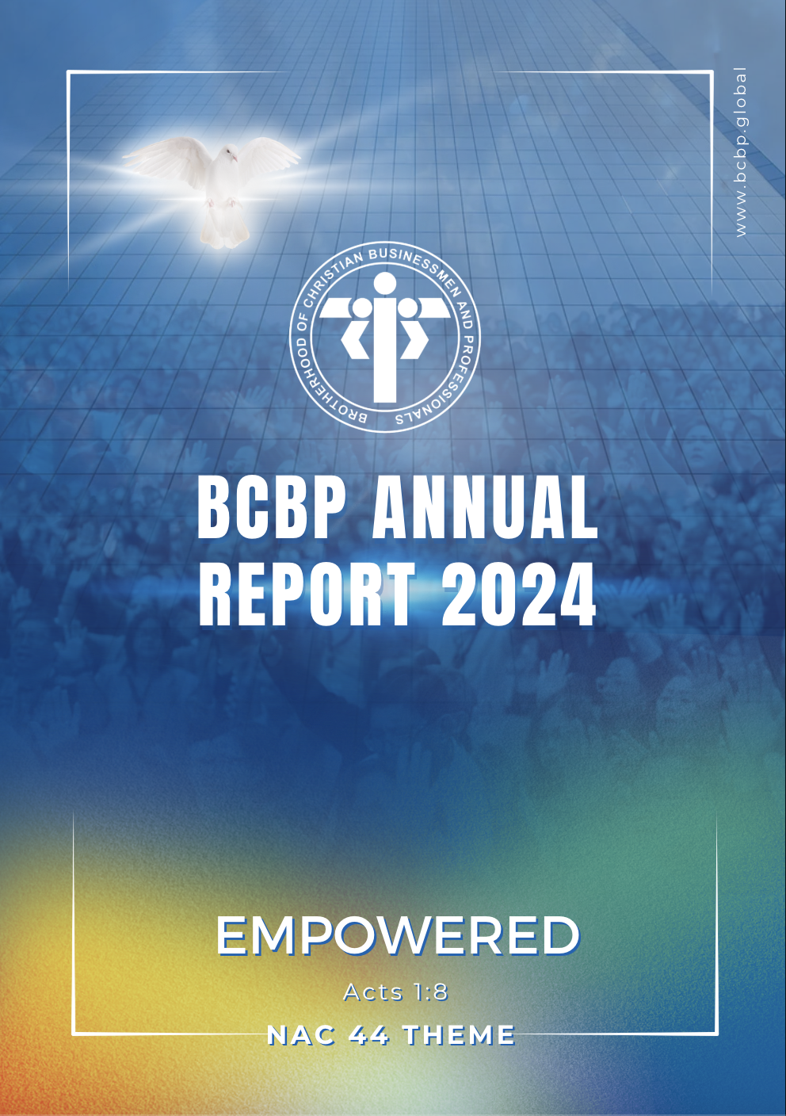
EMPOWERED
“But you will receive power
when the Holy Spirit has come upon you,
and you will be my witnesses in Jerusalem,
in all Judea and Samaria,
and to the ends of the earth.”
Acts 1:8

Slide 2
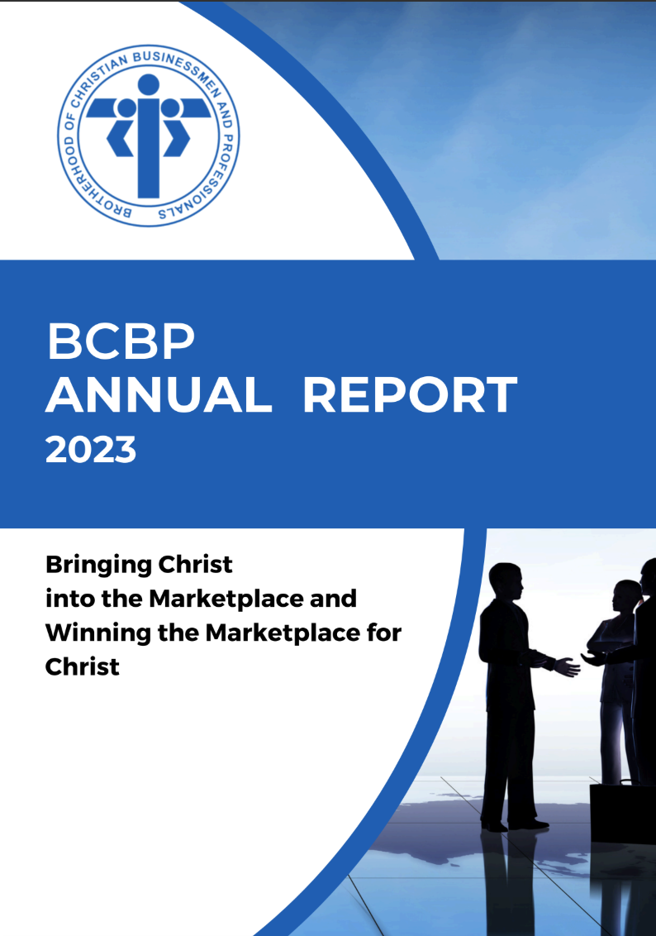
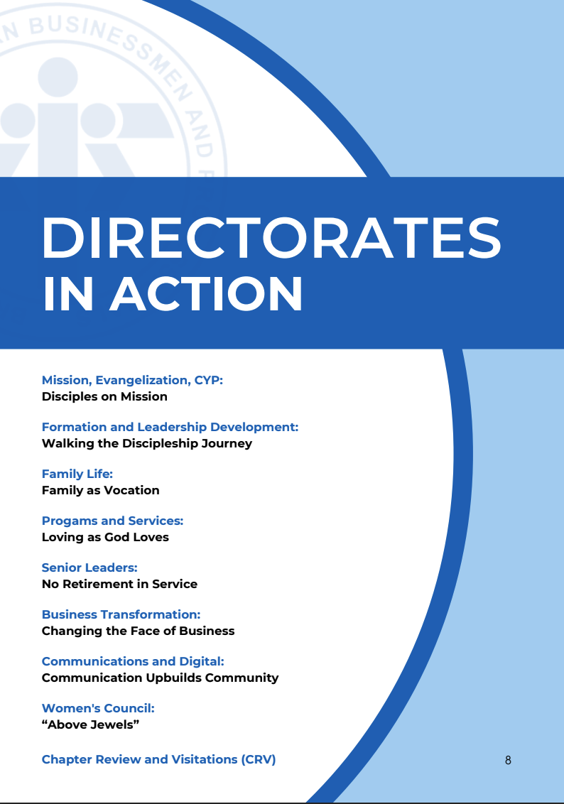
2023
Notes:
How many of you recognize this?
How many of you have actually read it?

Slide 3
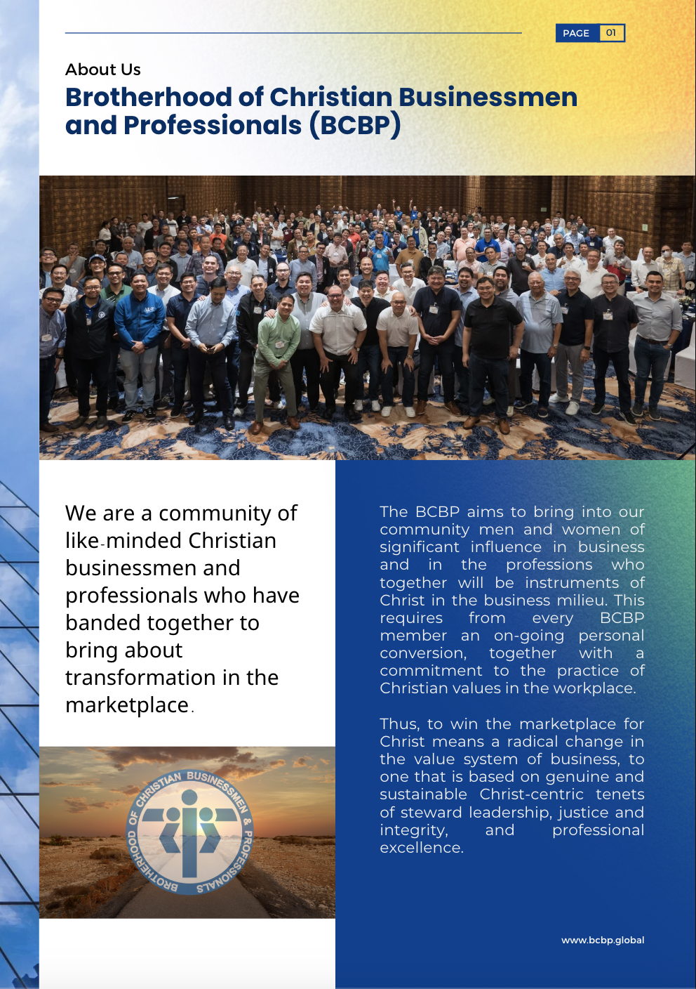
2024
Notes:
Over the past month, and then some, our leadership team, working closely with a dedicated group of writers and layout designers, has thoughtfully prepared our yearbook, so to speak, for the year just passed.

Slide 4
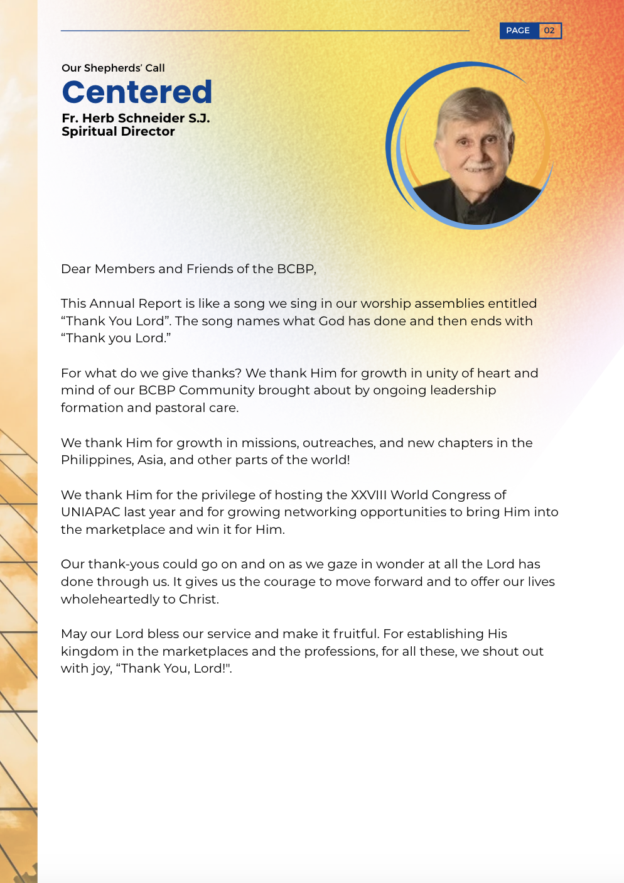
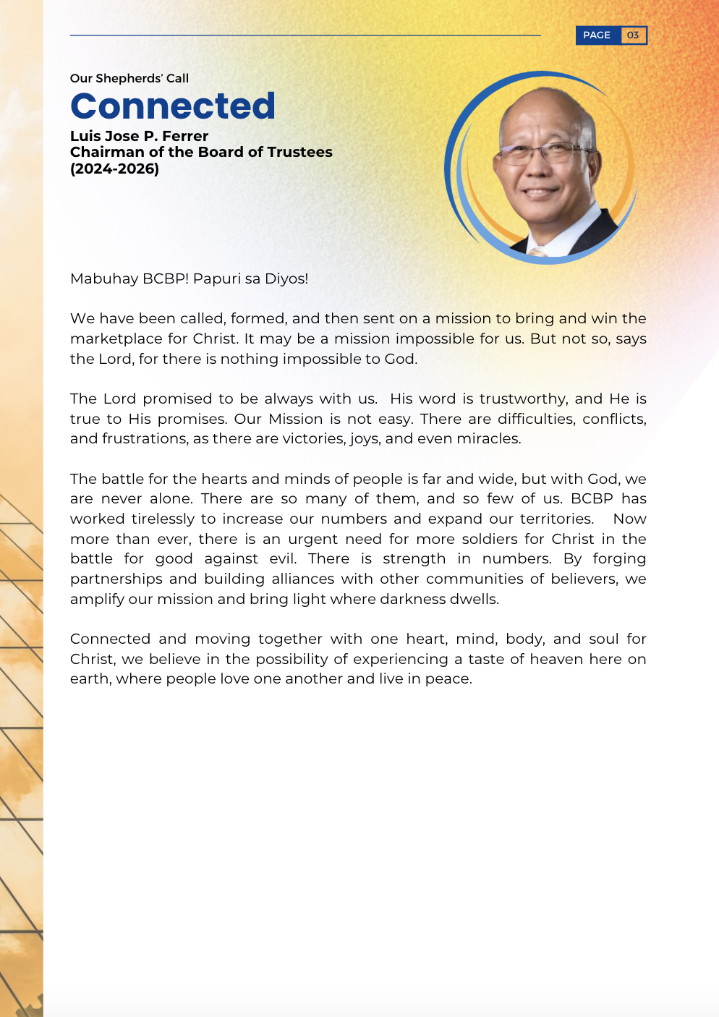
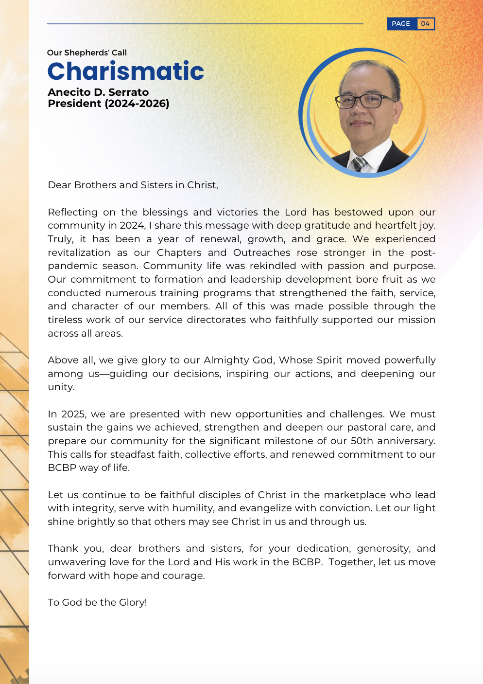
Notes:
It is with deep gratitude that I present our BCBP 2024 Annual Report.
In it, we are greeted with messages from our Founder and Spiritual Director, Fr. Herb, Chairman Luis Ferrer, and President Ani.

Slide 5
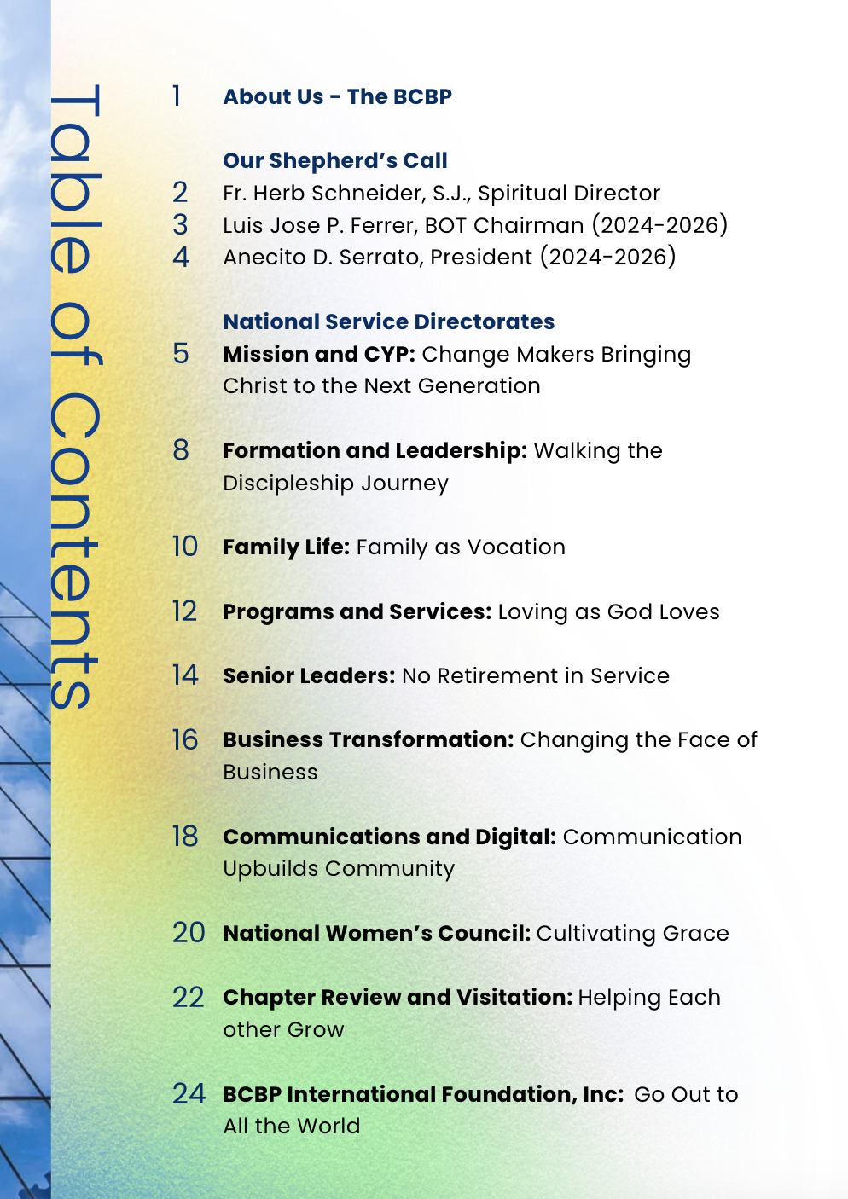
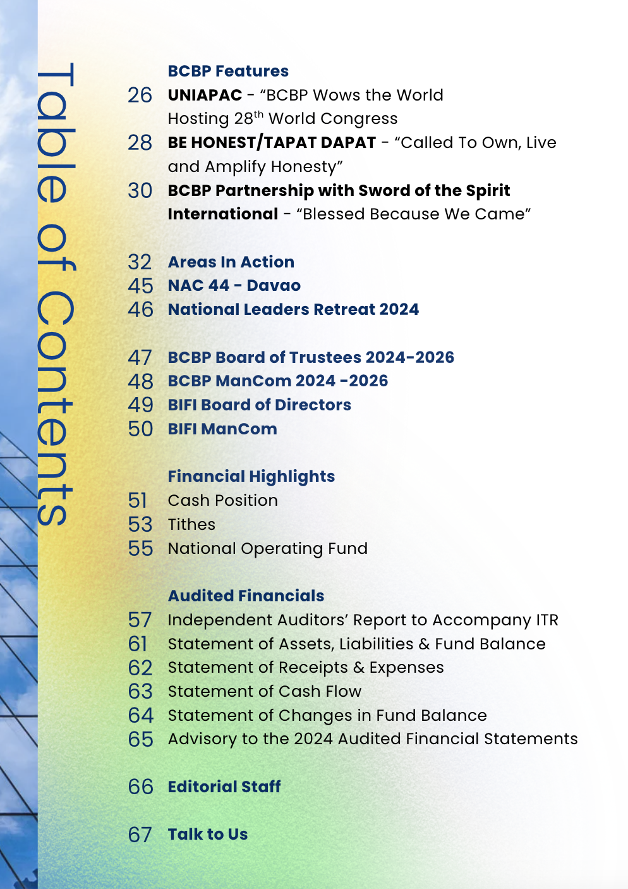
Notes:
Let me ask: how many of you have read an Annual Report at your workplace? Or come across one from another organization?
These reports are never just documents—they’re carefully crafted to reflect three core values: transparency, celebration, and reflection. Our community’s Annual Report ascribes to that same spirit.
And so, contrary to what you might expect, our AR isn’t just a list of programs, nor is it simply about numbers or financials.
It’s something deeper.
It’s a story — a living testimony of how our community, remaining faithful to our Mission, has journeyed together, and how every Directorate has played a crucial role in carrying that Mission forward.

Slide 6
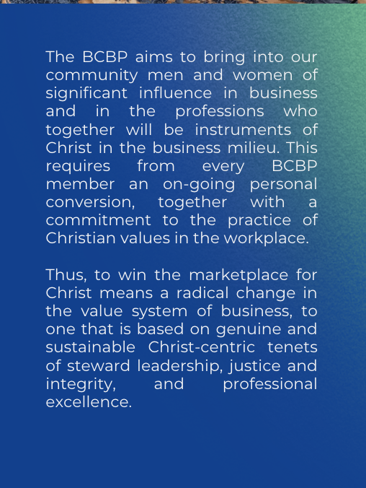
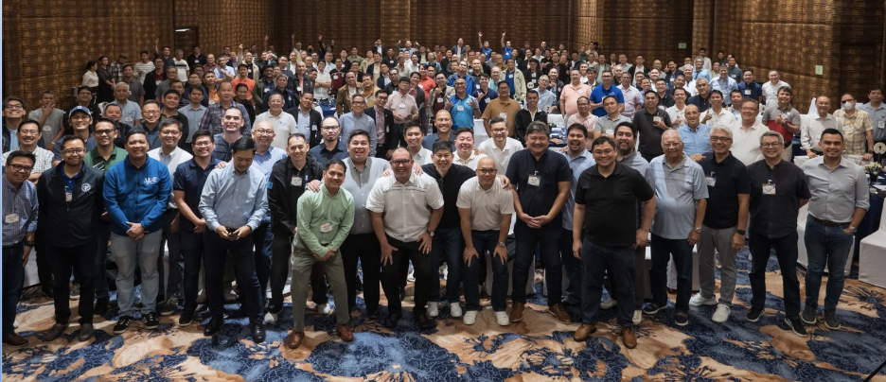

Notes:
It reinforces who we are, where we’ve been, and moving forward, where we are called.
It documents our shared journey as we align ourselves with the vision and goals we’ve committed to as one community.

Slide 7

Notes:
The overall theme for this year's report is “Empowered,” taken from the NAC 44 theme.
We acknowledge that all our programs and milestone activities were inspired and fueled by the power of the Holy Spirit, who is our constant companion and guide in our spiritual journey.

Slide 8
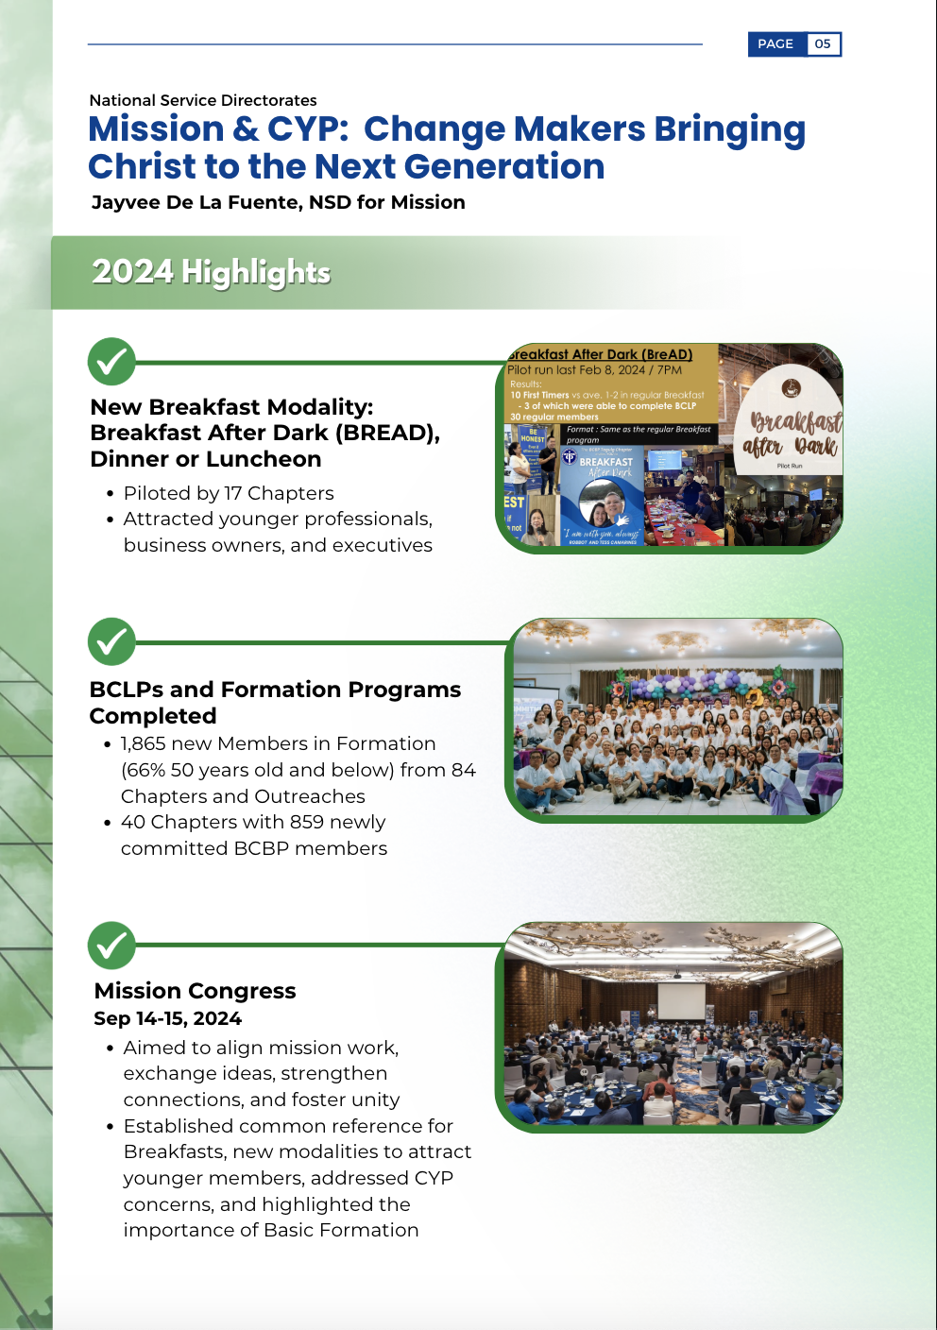
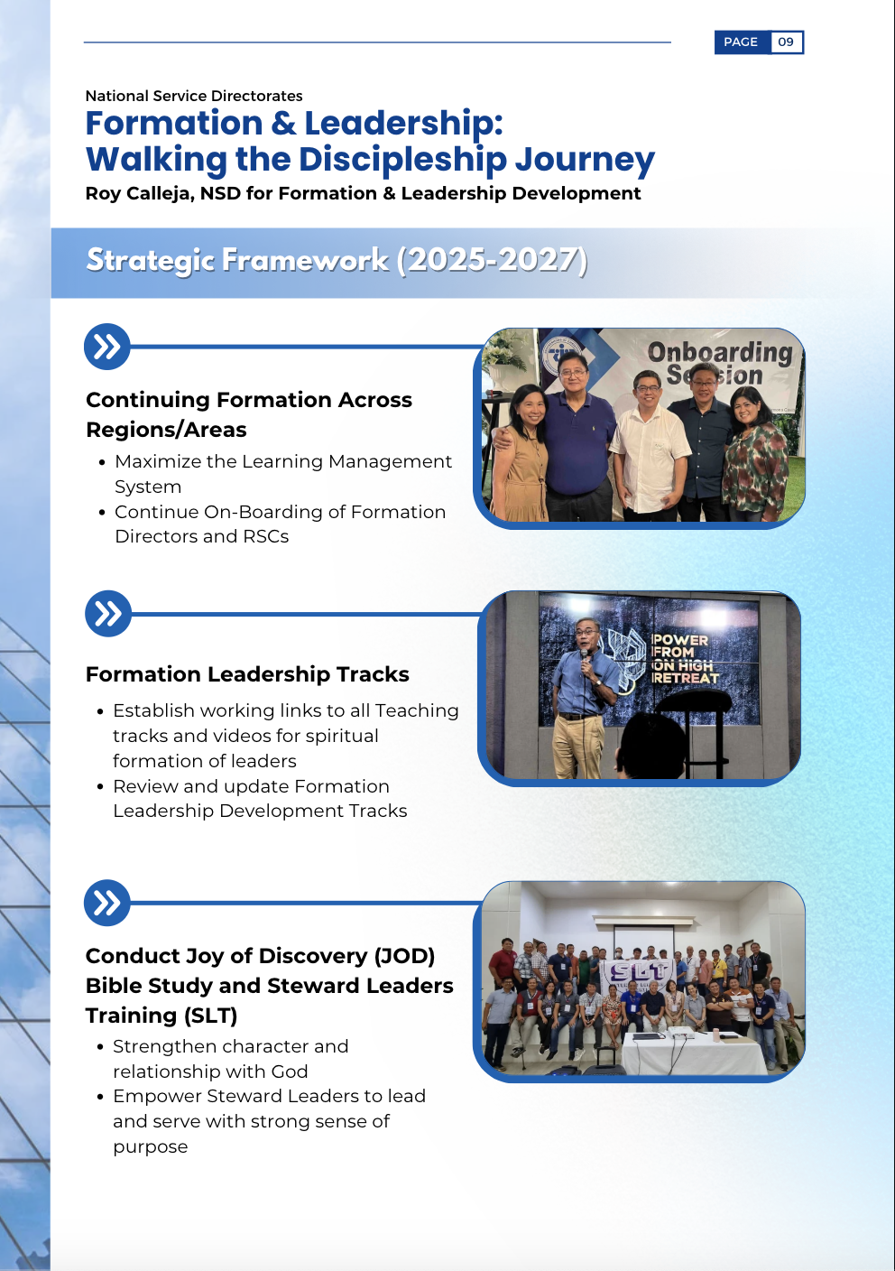
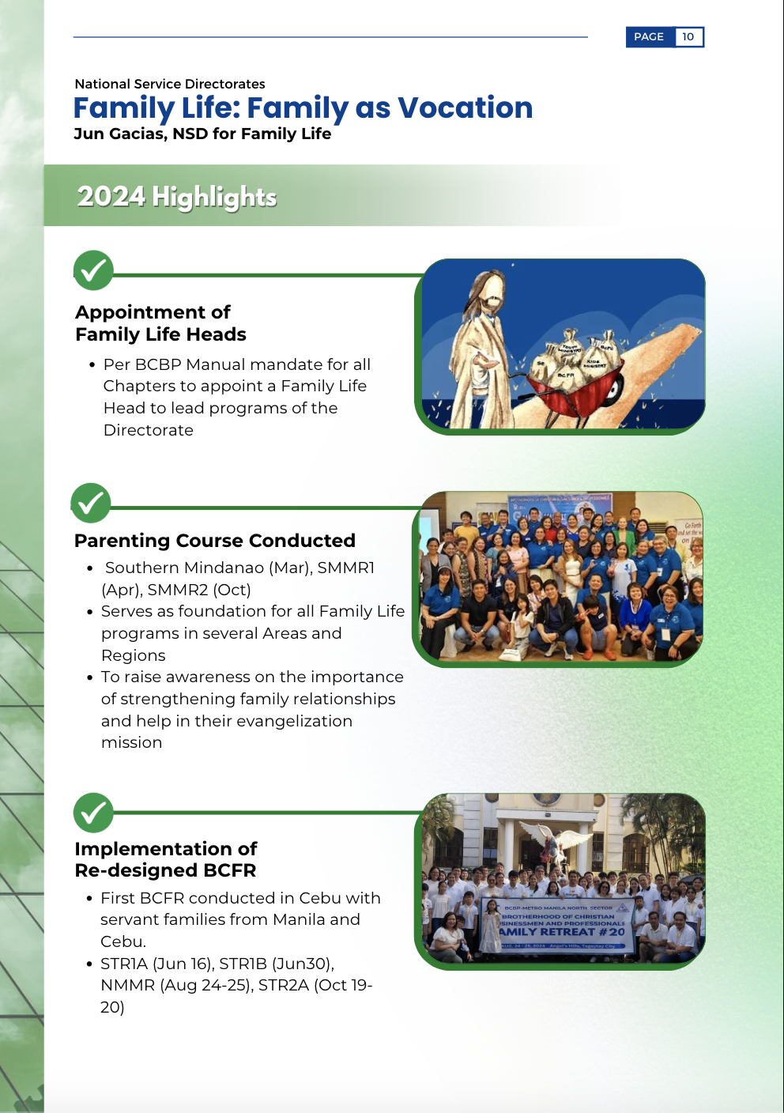
Notes:
Close to 70 pages, the report may seem intimidating, but don’t worry… it celebrates milestones, reflects on challenges, and recognizes the quiet, powerful acts of service by the men and women of BCBP.

Slide 9
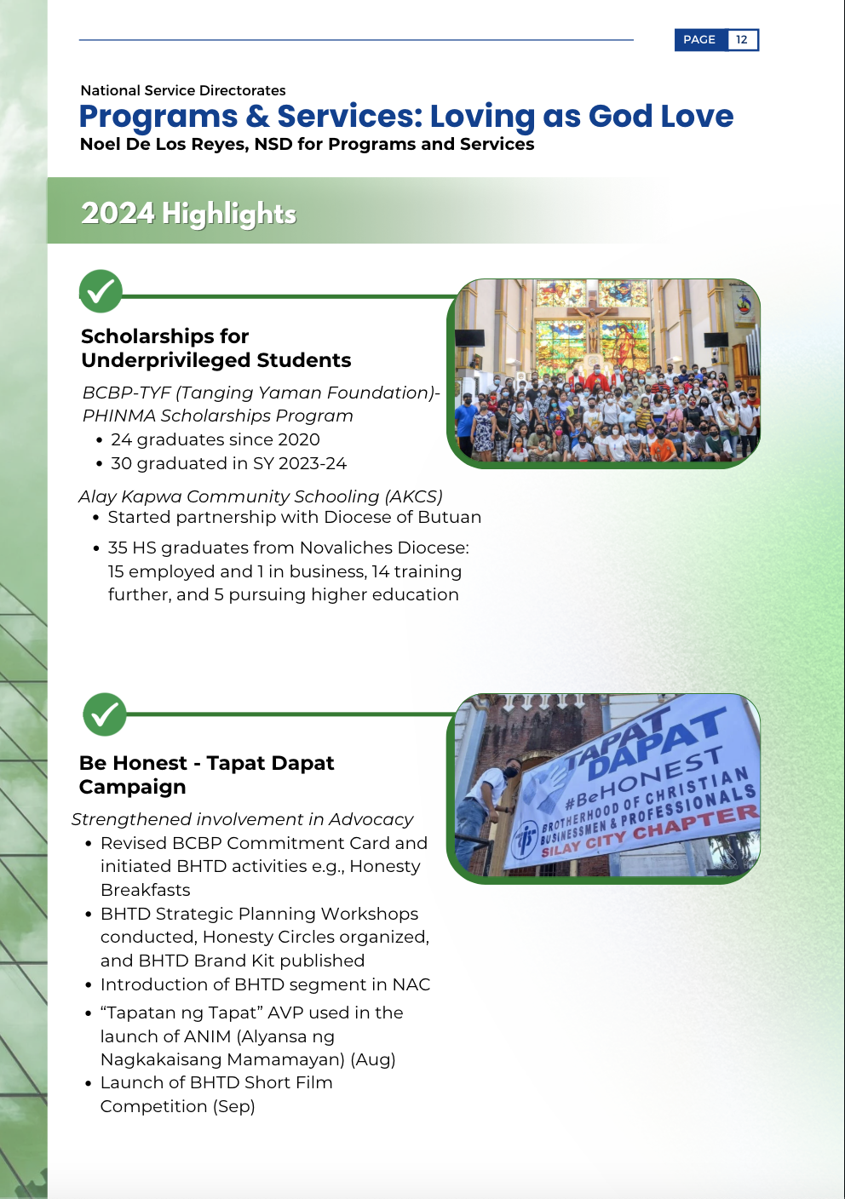
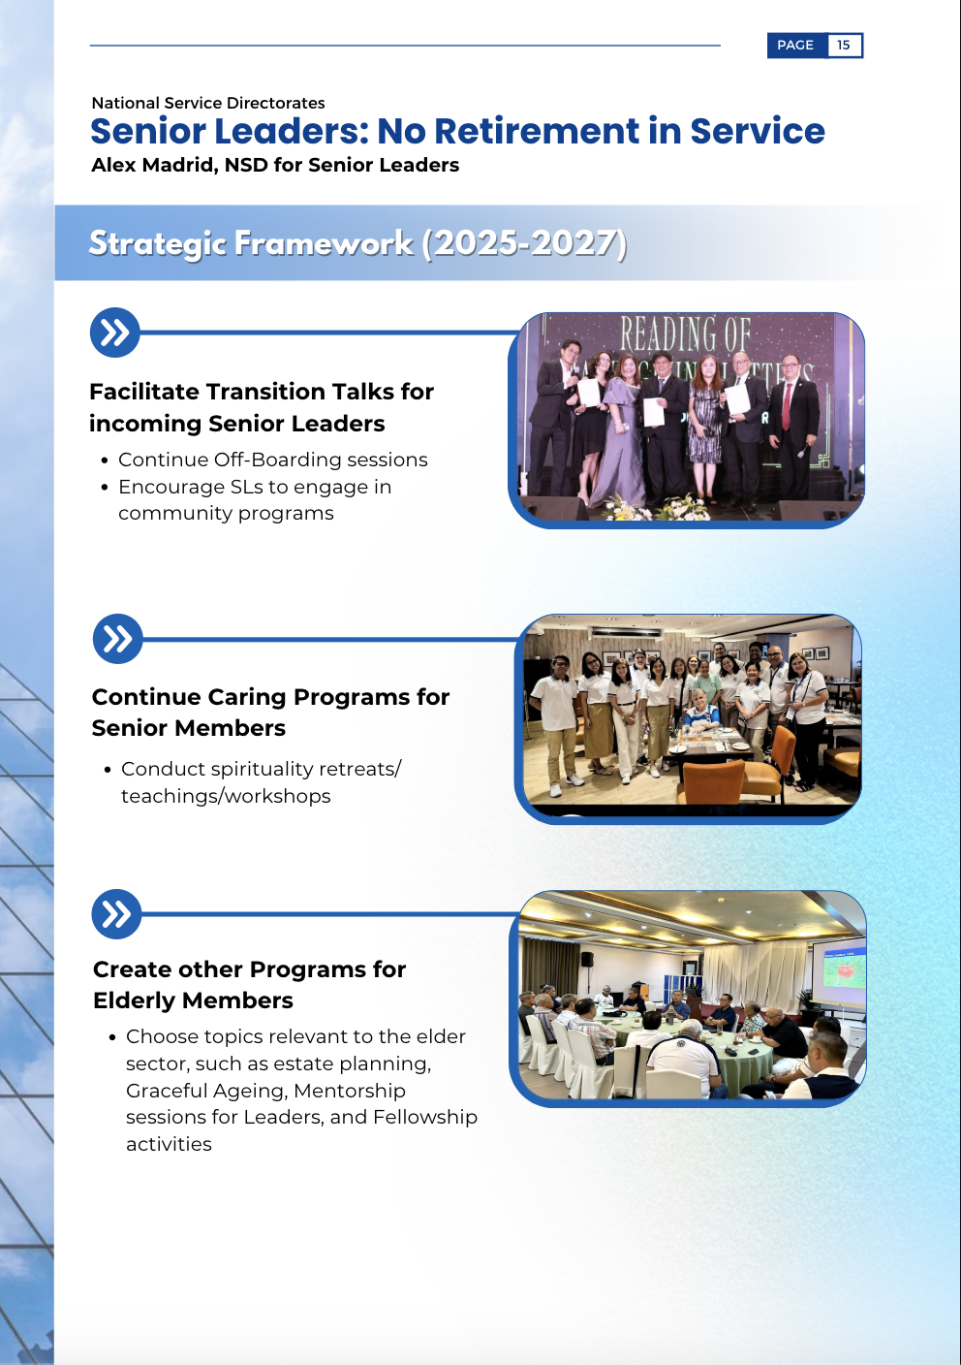
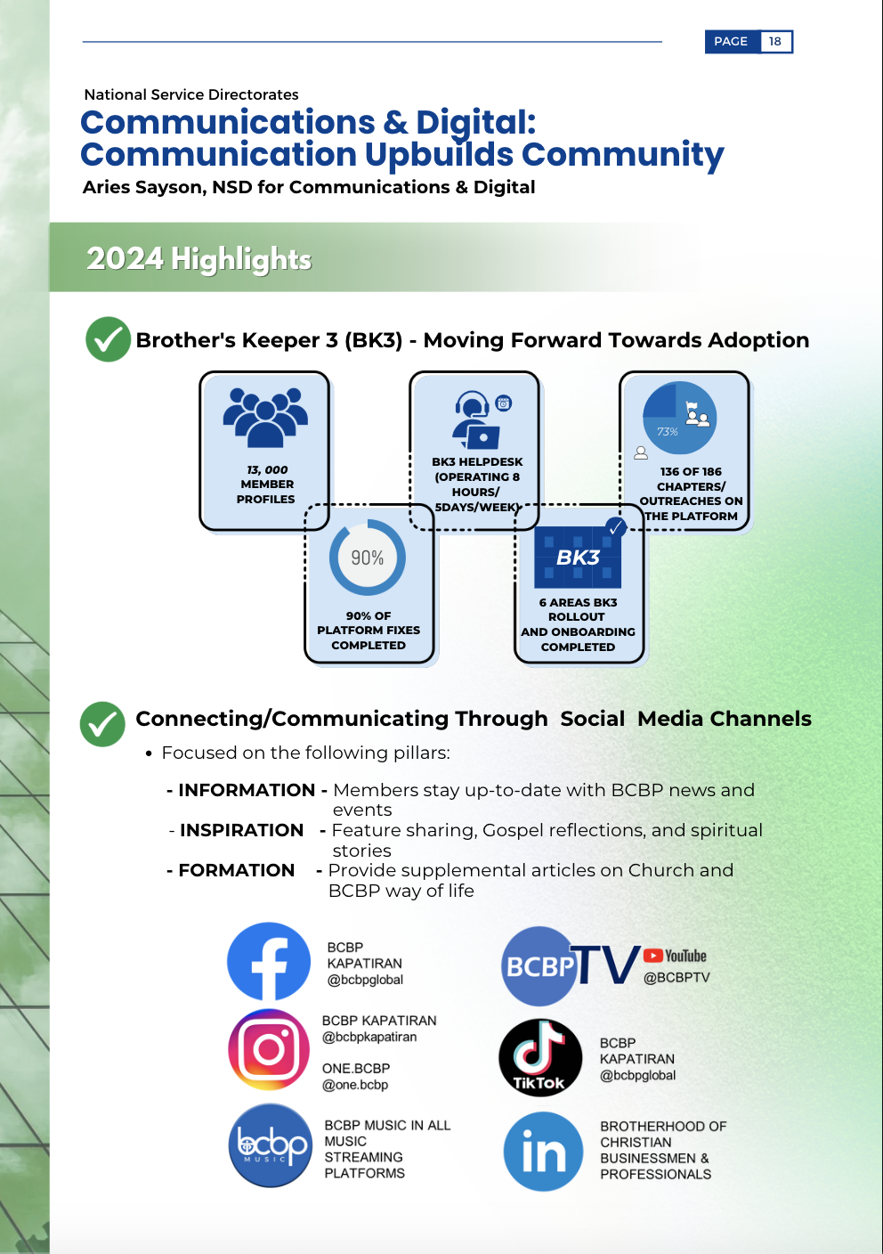
Notes:
You’ll see the fruits of our efforts—the highlights and achievements of our Directorates and spiritual moments that shaped us this past year

Slide 10
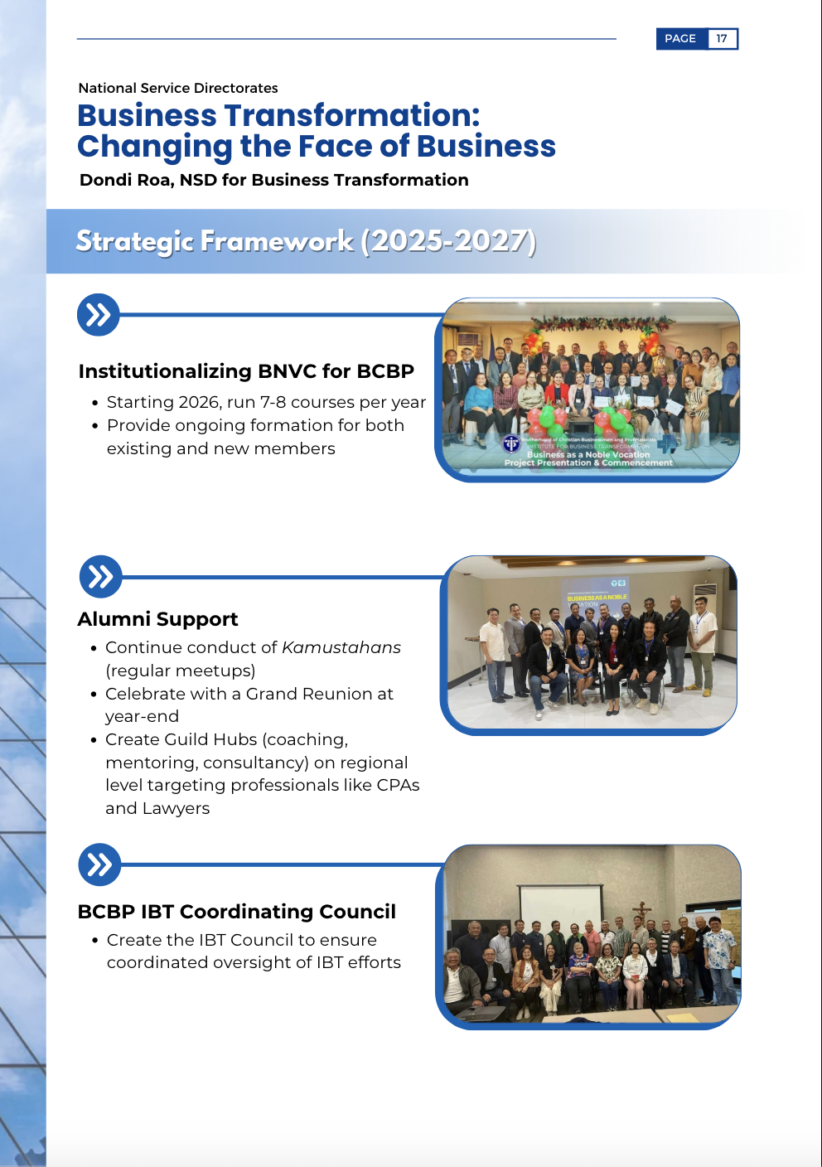
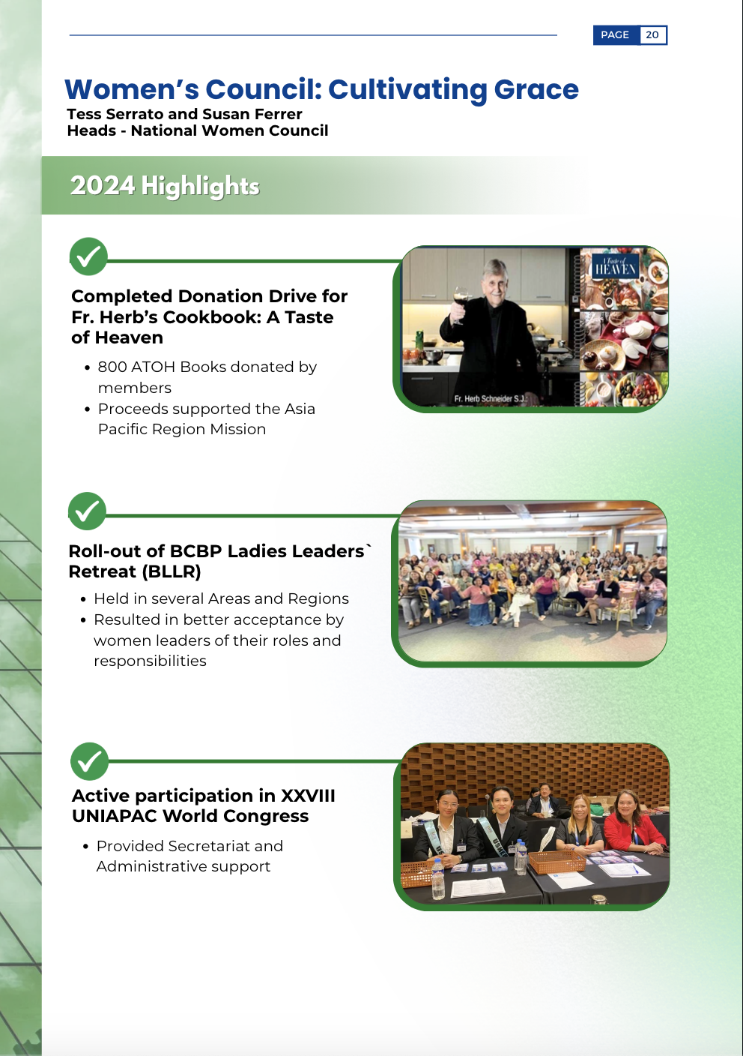
Notes:
The same Directorates will cast a shared vision for the future, 2 or 3 Strategic Frameworks for 2025 and beyond, where God might be leading us next, and how each one of us can be part of that plan.

Slide 11
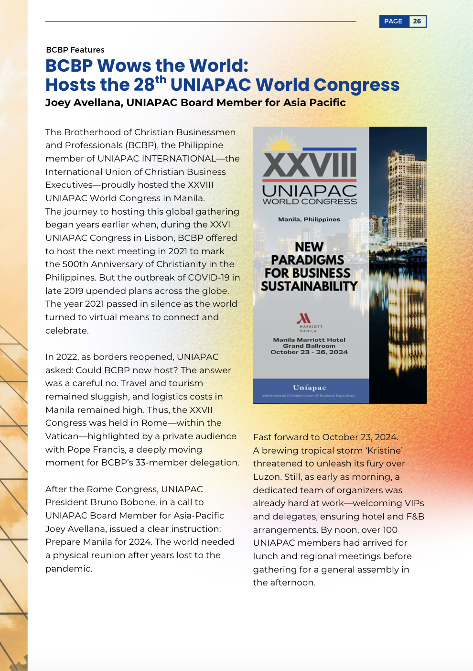
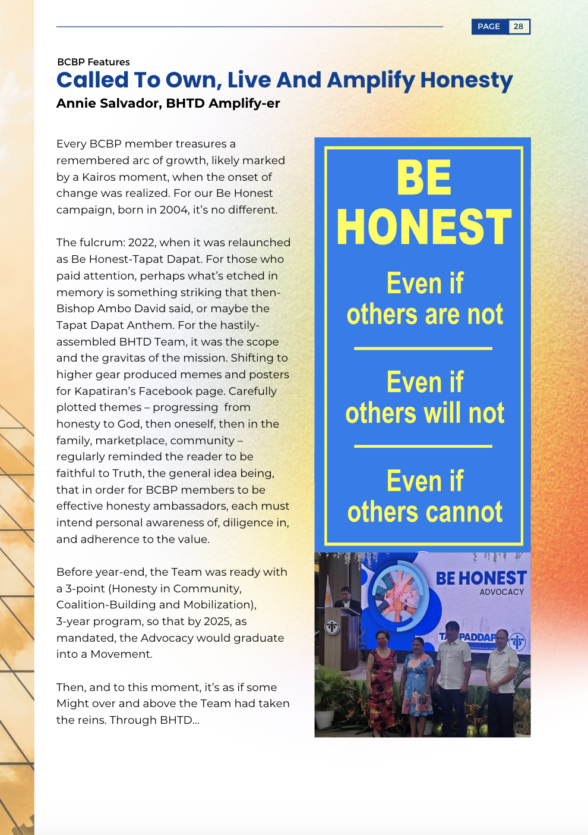
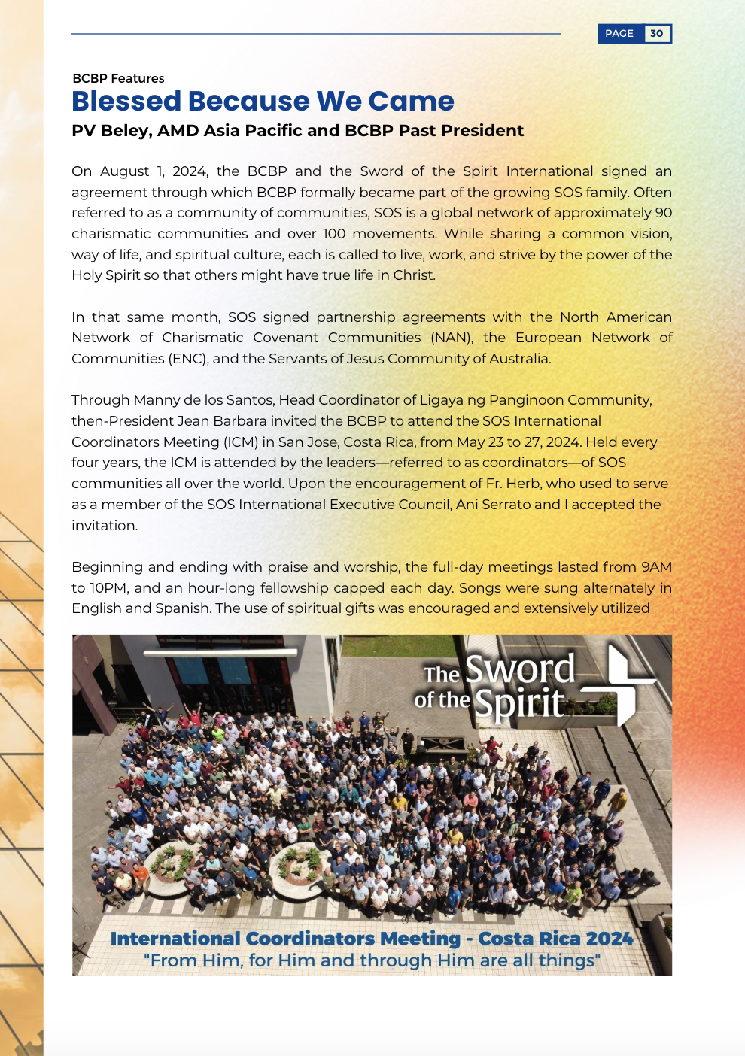
Notes:
For the first time, the AR features articles covering UNIAPAC, the Be Honest/Tapat Dapat Advocacy, and our partnership with the Community of communities – Sword of the Spirit.

Slide 12
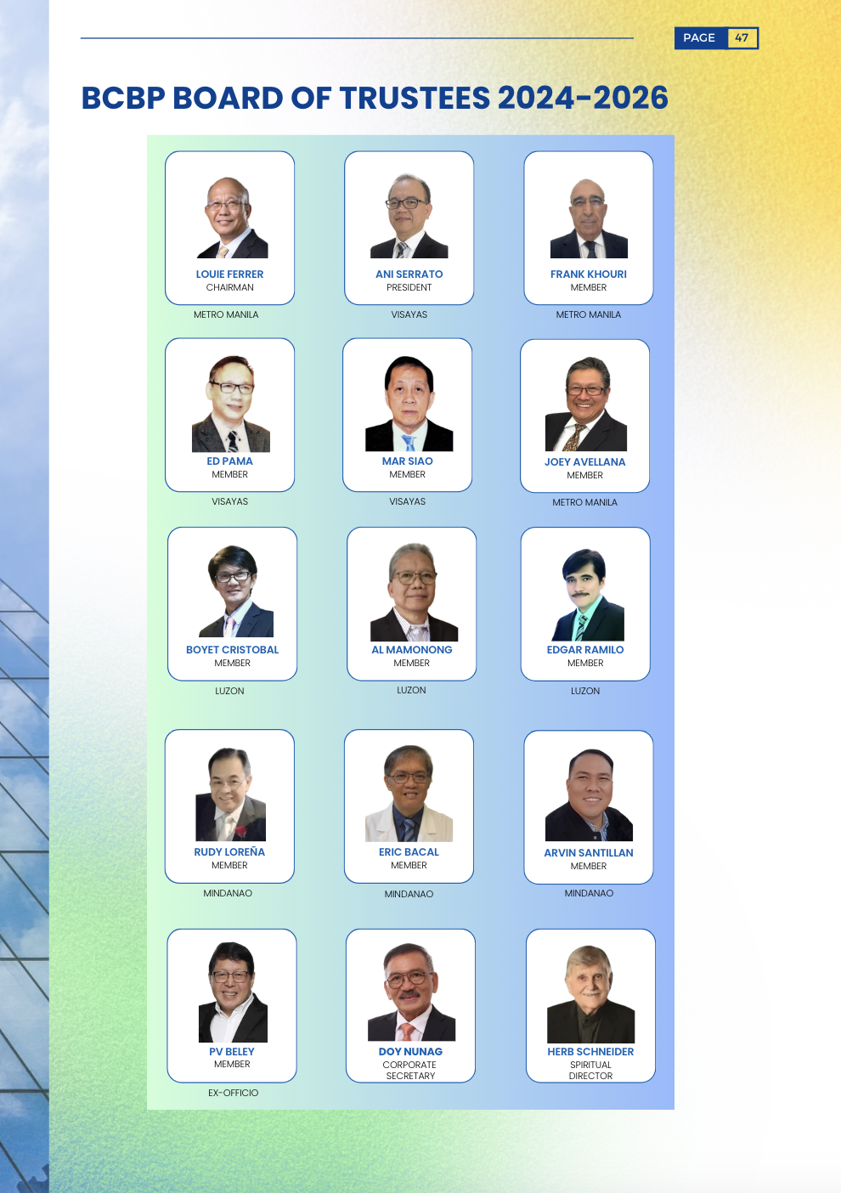
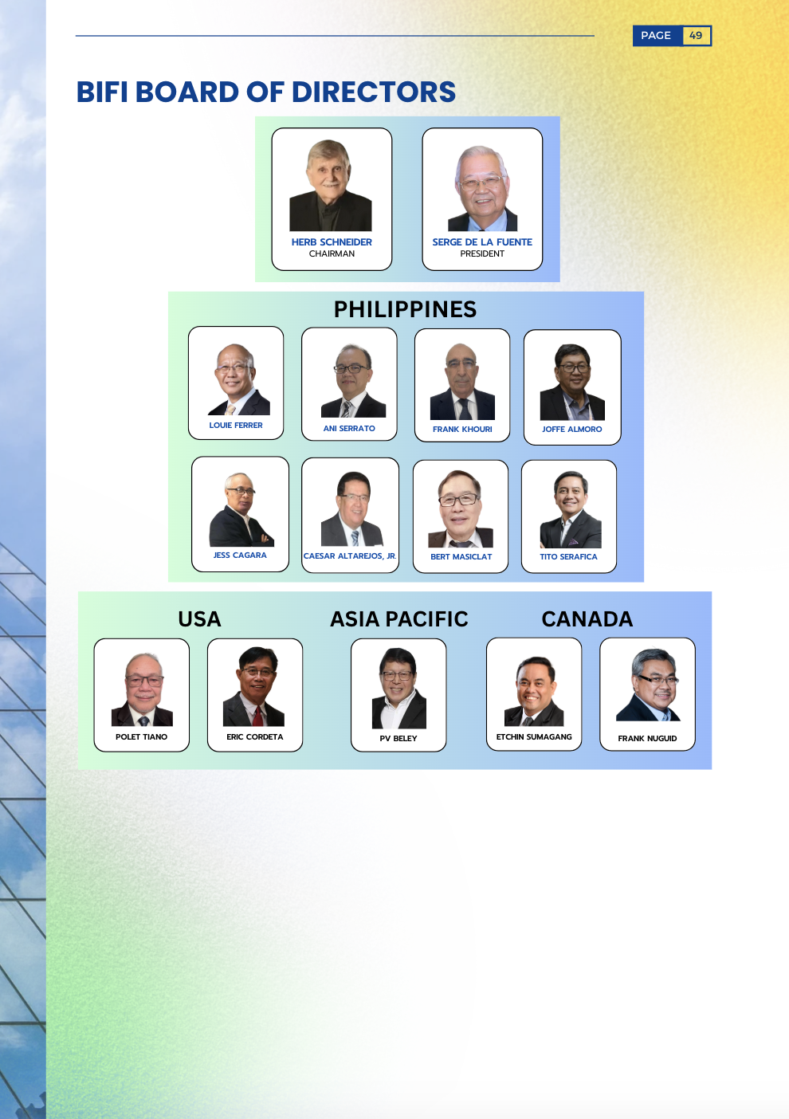
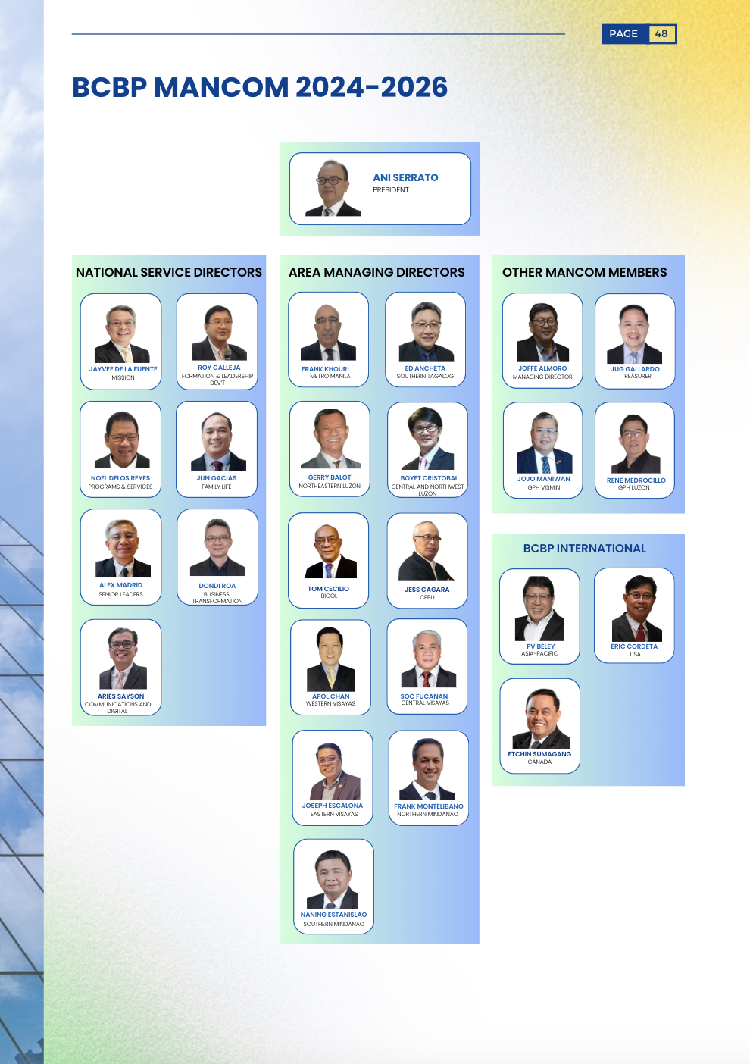
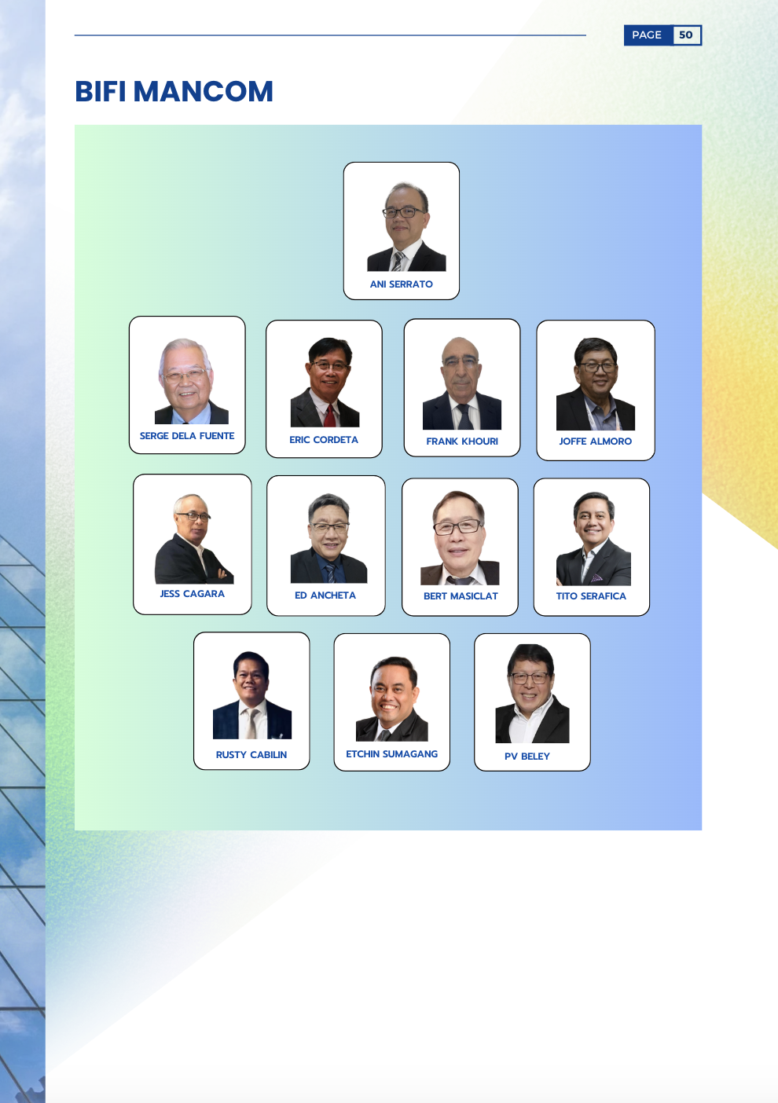
Notes:
Behind all this hard work stand our dedicated servant leaders.
You will meet each one in this report: our BOT, Mancom, and BIFI as well. What, you say?
The BIFI is the Brotherhood Int’l Foundation, Inc., and yes, that’s us too.

Slide 13
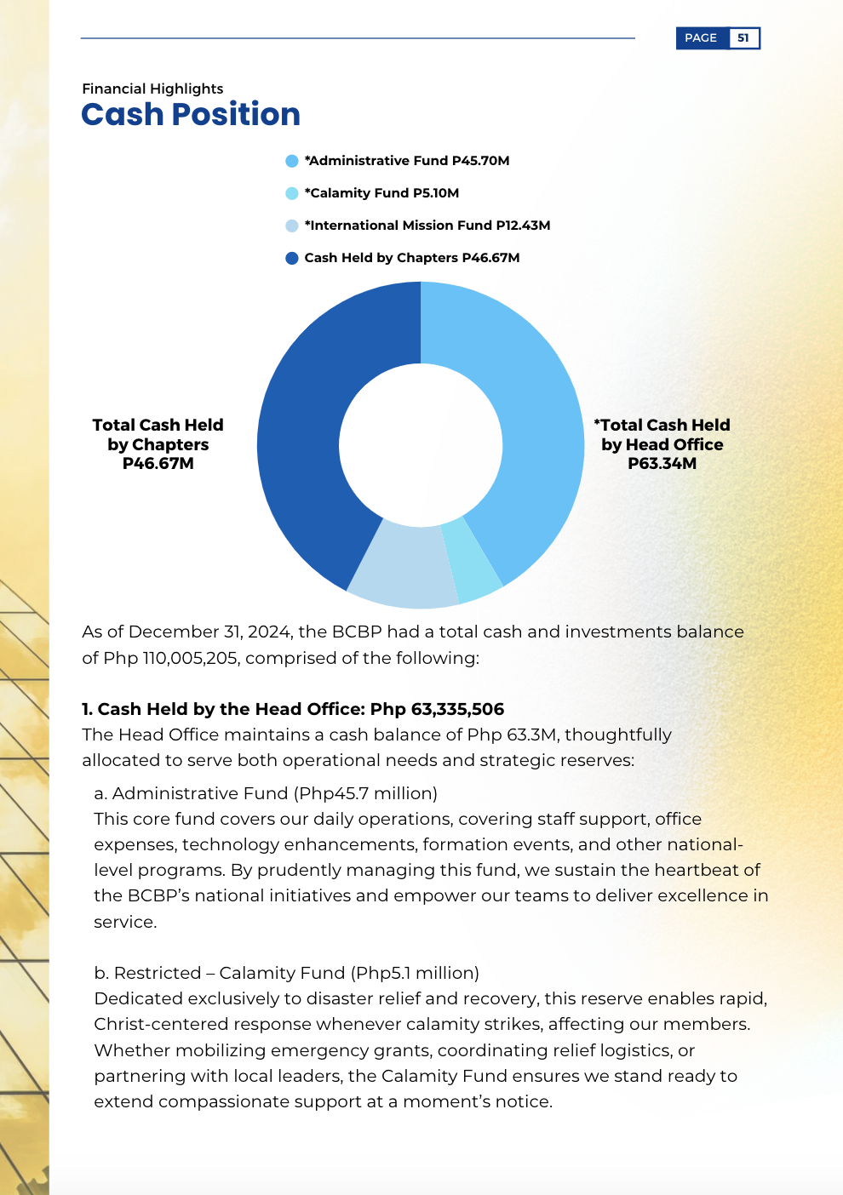
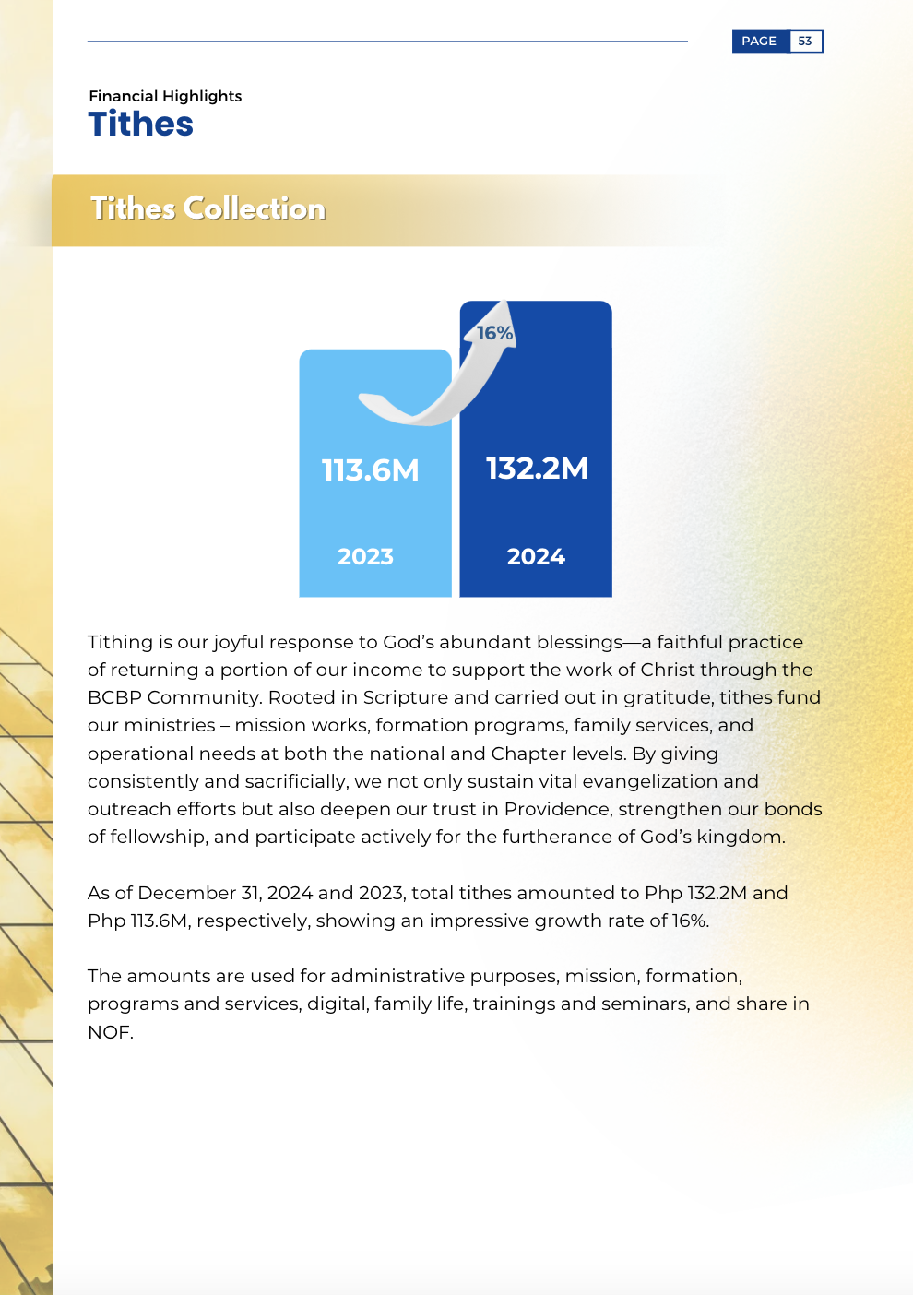
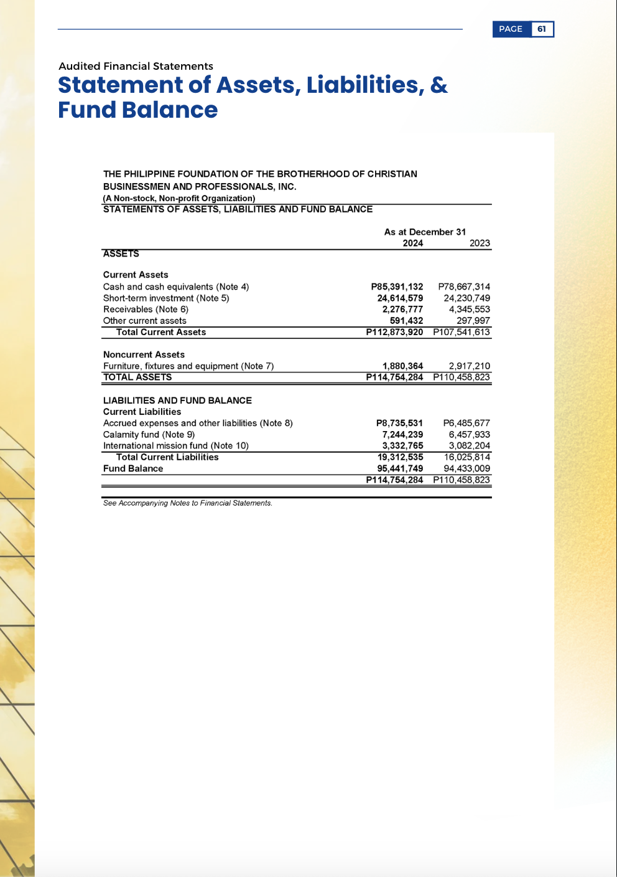
Notes:
And what would an Annual Report be without its Financial Statements? Financial reports reflect stewardship and resource management practices, thus reinforcing accountability and the wise use of tithes and contributions. To safeguard our privacy, however, we will not include these financial reports on social media posts, such as in Kapatiran FB.

Slide 14
INVITATION
Reflect
Appreciate
Re-commit
Notes:
Finally, brothers and sisters, let us all recognize that this AR2024 is more than a formal report - it’s an invitation for each of us to reflect, to appreciate, and to re-commit ourselves through our service ministries.

Slide 15
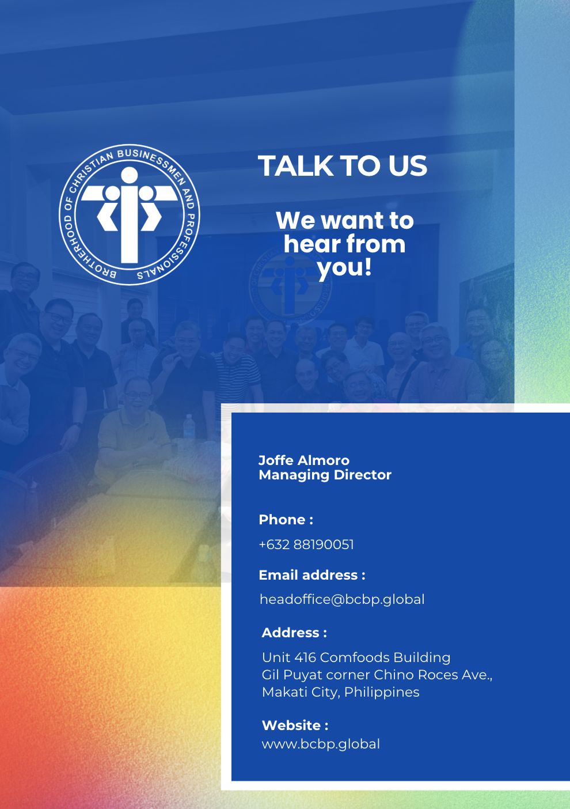
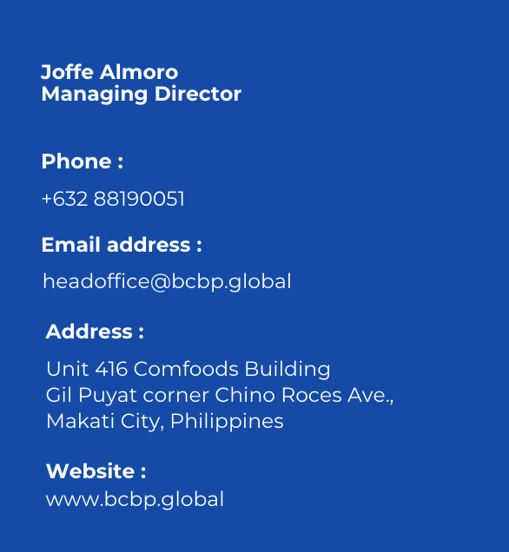
Notes:
The BCBP leadership encourages every member to voice out any questions or concerns.
If you need clarification, please feel free to contact me or any of our leaders.
You can also get in touch with Joffe Almoro, our Managing Director and he will be happy to hear from you.

Slide 16
Let’s all look forward and together participate in the continued unraveling of the Holy Spirit’s and our community’s love story – for each one of us is truly a vital part of this journey.
Notes:
Let’s all look forward and together participate in the continued unraveling of the Holy Spirit’s and our community’s love story – for each one of us is truly a vital part of this journey.

Slide 17
Thank you and God bless us all!

